Slide 1
INSECTS

Slide 2
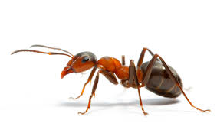
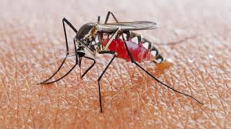
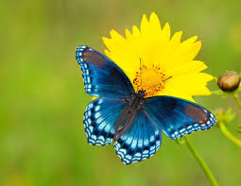
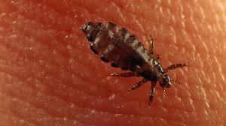
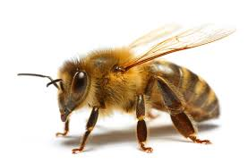
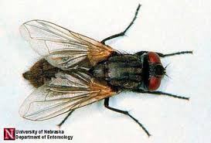
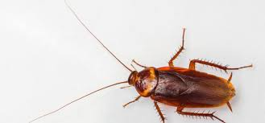
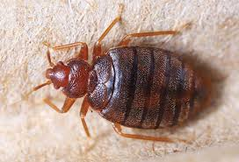
CHARACTERISTICS OF INSECTS
An insect is a very tiny animal that do not have bones, but they have outer covering shell which protects them. Most of the insects consist of six legs, or even more than that. Insects live in the forest, trees, grass, walls of houses etc.

Slide 3
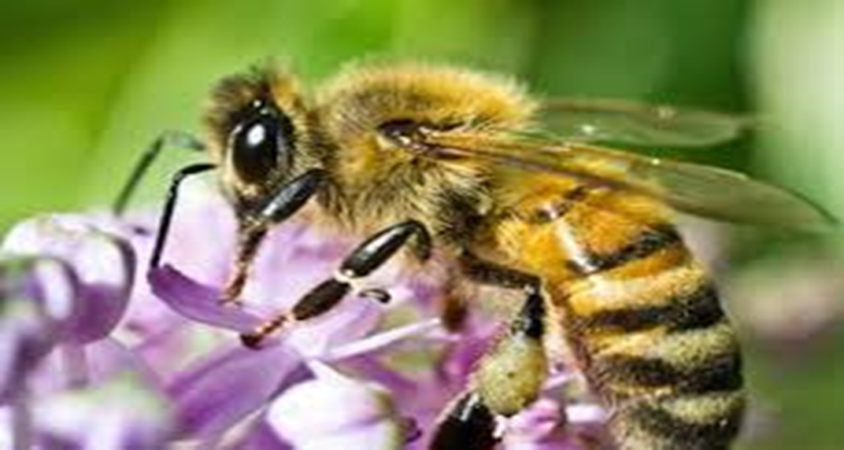
HONEY BEE
This is a honey bee or a bee. It collects honey from the flowers. It lives in the hive with other bees. It also gives us honey which taste nice and sweet.

Slide 4
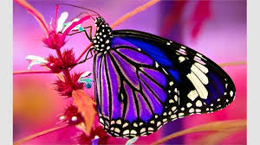
BUTTERFLY
This is a butterfly. It has a thin body with large coloured wings. The wings have many colours. They love eating sweet nectar (honey) from the flowers. It lives in the garden.

Slide 5
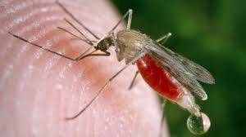
MOSQUITO
This is a mosquito. It has two antennas and six long legs. It lives in the grass, dirty water and at our homes. It loves to drink blood of humans and animals. It is harmful to human health and can cause malaria and dengue.

Slide 6
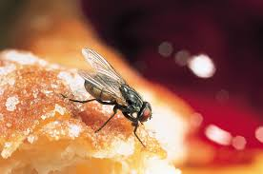
HOUSEFLY
This is a house fly or a fly. They have two wings and six legs. They can fly up and down even backwards. They like eating rotten food.

Slide 7
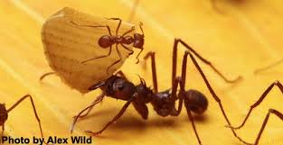
ANT
This is an ant. It is very small in size. It is red and black in colour and has six legs. It collects food and stores them and then eats them later.

Slide 8
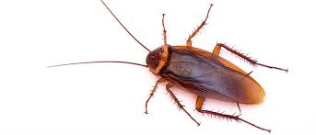
COCKROACH
This is a cockroach. It is black or brownish in colour. They like to eat sweets, meat and leftover food. They are most active at night. They live in warm, dark, wet areas like drains, basements and other corners of the house.

Slide 9
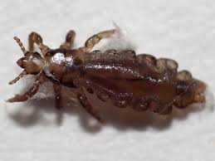
LOUSE
This is a louse. It is a small wingless insect that lives in the skin of mammals. They cannot jump, they can only crawl. They feed on human blood.

Slide 10
BED BUG
This is a bed bug. It is an insect that feeds on human blood usually at night. They do not spread disease but their bites can become red and itchy.

Slide 11
WORK TO DO
Q1.Look at the pictures and write down the name of the insects.
Q2.Fill in the missing letters.
Q3.In your science exercise book write down the name of 8 insects and stick pictures.

