Slide 1
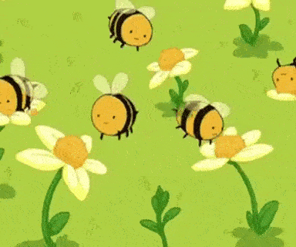

Chapter 2
PART II
SEXUAL REPRODUCTION IN PLANTS AND ANIMALS

Slide 2
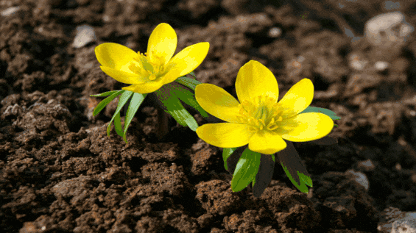
SEXUAL REPRODUCTION IN PLANTS
Plant reproduction is the production of new offspring in plants both asexually and sexually, but majority of the flower reproduce sexually.

Slide 3
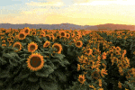
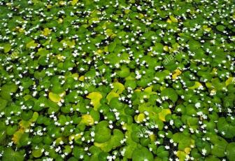
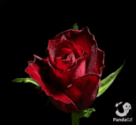
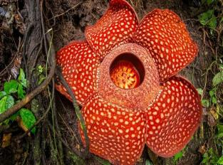
FLOWER
Flower is a specialised shoot in which the leaves are modified into floral structures. It is responsible to produce seeds that grow into new plants. Flowers are of different sizes, shapes and colours. Duckweed blossom is the microscopic flower whereas Rafflesia arnoldi is the largest flower.
Bisexual or Hermaphrodite : Flowers the make both the male and female gametes are called hermaphrodite. E.g. China rose, mustard etc.
FUNCTION: It helps in the development of fruits and seeds. Bright colour of the flower, fragrance and the sweet nectar attracts insects and birds for pollination.

Slide 4

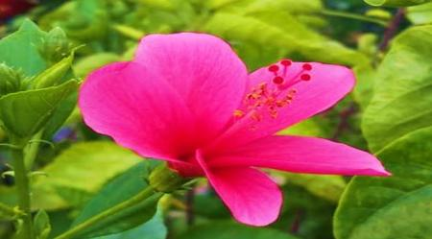
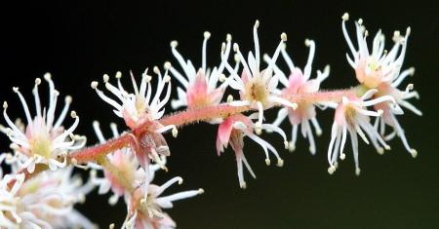
The floral parts are all attached to an enlarged section of the stalk called receptacle.
Stalk: A stem that supports or attaches a flower.
Receptacle: It is cup shaped expanded part from which the flower
parts grow.
Pedicillate flower: A flower with stalk is called a pedicellate flower. E.g. hibiscus, rose
Sessile flower: A flower without a stalk is called a sessile flower. E.g. sunflower florets, saffron
receptacle

Slide 5
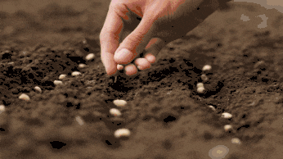
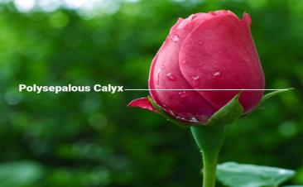
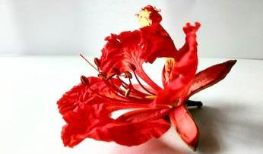
Whorls of a flower
1. First whorls: Sepals or calyx are green
in colour. It can be free or fused.
When the sepals are green, it is called sepaloid (Rose).
When the sepals are coloured it is
called petaloid (Gul Mohur)
Function: It protects the
young flower bud, perform
photosynthesis when green in
colour.

Slide 6
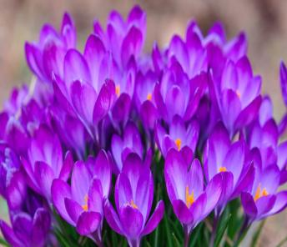
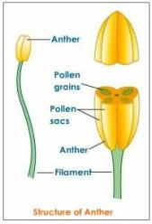
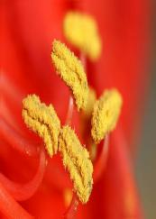
Second whorl: Corolla or petals are the attractive coloured part of a flower. They can be arranged in single whorl or double whorl and can be free or fused.
Function: It attracts insect for pollination.
Third whorl: Androecium/ Stamens:
The stamens of a flower collectively are called
androecium. Stamen has two regions: Filament and anther.
Anther contains pollen grains ( male gamete).
Pollen grains: Pollen grains are yellow
powdery substance of
different shapes and sizes.

Slide 7
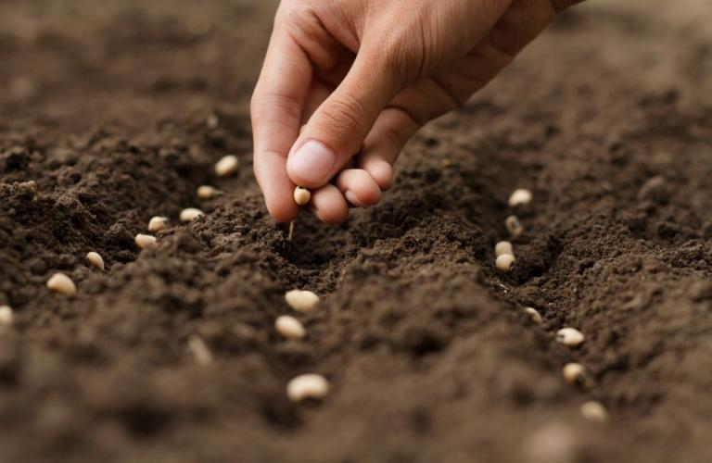
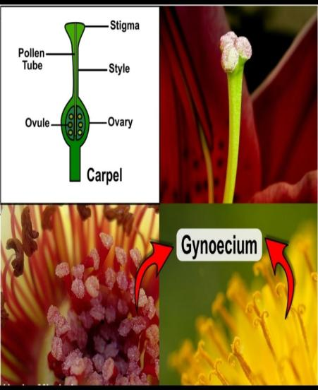
Fourth whorl/ Gynoecium: The female part of a flower, consists of one or more carpels.
Each carpel consists of three parts:
Stigma: Terminal lobed, divided
into two/more lobes, may have
feathery appearance or sticky in nature.
Function: Serves a landing place for
pollen during pollination.
b. Style: Tube like slender stalk.
Function: Connects stigma to ovary.
c: Ovary: Swollen basal portion with
one/more carpels.
Function: It contains ovules which
contains the eggs/female gametes)

Slide 8
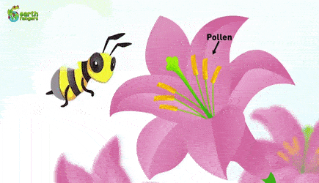
POLLINATION
It is the transfer of pollen from anther to stigma of the same plant or a different plant of same species. It is usually followed by fertilisation and later on by the formation of seed.

Slide 9
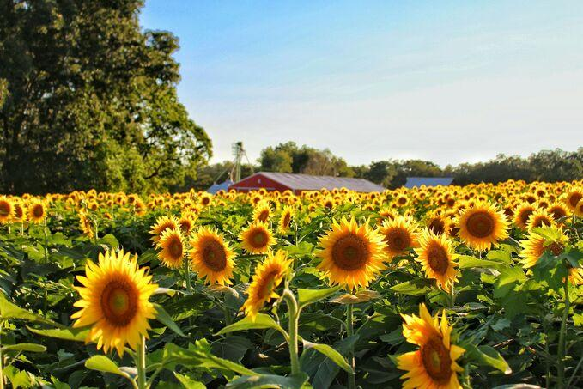
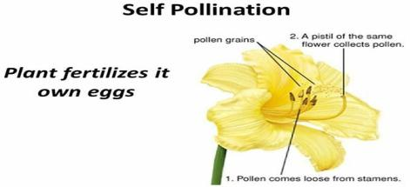
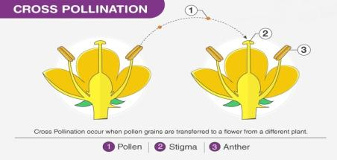
Types of pollination
Self-pollination
The transfer of pollen from the anther to the stigma of same flower is called self-pollination. E.g. Wheat, rice, groundnut, etc.
Cross-pollination
The transfer of pollen from the anther of one flower to the stigma of another flower of the same species is called cross-pollination. E.g. Ladies finger, sweet pea, peepal, etc.

Slide 10

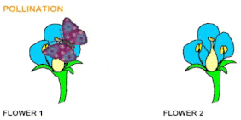
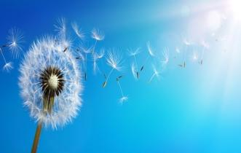
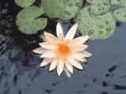
Agents of Cross-pollination
Bird and insect pollinated flowers are usually large, brightly coloured, scented and produce nectar. E.g. marigold, salvia, dahlia. When an insect arrives at the flower in search of nectar, some pollens get rubbed at their back. Now when the same insect visits other flowers for nectar, then the pollen at its back gets rubbed on the stigma of other flower and fertilisation takes place.
Wind- pollinated flowers are small in size, not brightly coloured and do not produce scent or nectar. Pollens are produced in large quantities and light in weight. E.g. maize, wheat, palm, etc.
Water-pollinated flowers produce pollens in large quantities. Some pollens have specific gravity equal to water so that they remain floating below the surface of the water. E.g. Vallisneria, water lily, etc.

Slide 11

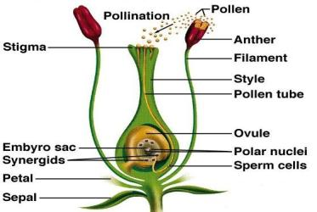
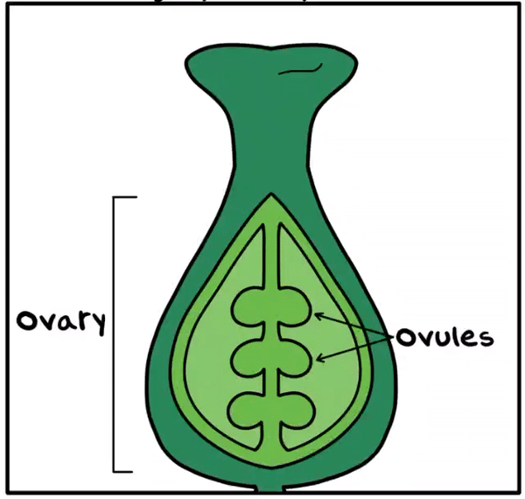
FERTILISATION IN PLANTS
Pollen grain from flowers
Pollinated by wind, water, insects
Stigma of flower of same species
Formation of pollen tube
Reaches to ovule
Fusion of male and female gametes
Syngamy process
Zygote

Slide 12
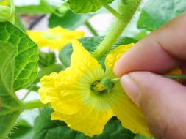
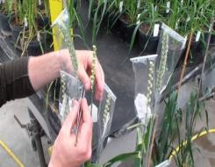
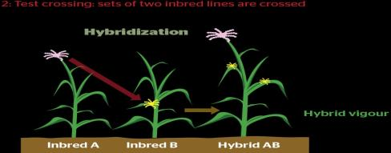
ARTIFICIAL POLLINATION
It is a way to produce a new variety of a crop plant with certain good characteristics. Two varieties of plants with desired characteristics are selected.
Emasculation
When the stamens of bisexual flower are removed before its anther matures.
Bagging
When the gynoecium is kept intact by covering it with a paper or a polythene to prevent natural pollination.
Hybridisation
The process of crossing two plants to get a new variety of plant possessing the good characteristics of both the plants is called hybridization. The new variety formed is called a hybrid. It produces many high yielding varieties (HYV) of rice, wheat, mango, tomatoes, pea, etc.

Slide 13
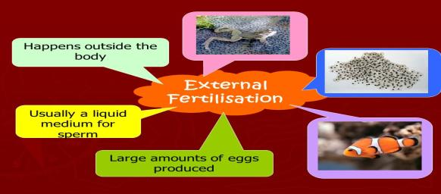
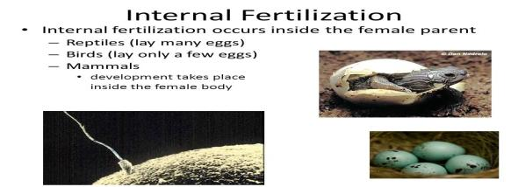
SEXUAL REPRODUCTION IN ANIMALS
The reproduction in which sex cells are involved is called sexual reproduction.
External Fertilisation: In many invertebrates, when fertilisation takes place outside the female’s body, it is called external fertilisation. E.g. Fishes, amphibians.
Internal Fertilisation: When the fertilisation takes place inside the female body, it is called internal fertilisation. E.g. All reptiles, birds and mammals.
Hermaphrodite or bisexual animals are those animals in which both the organs are present, which produces both sperm and ova. E.g. earthworm, tapeworm, leech etc.

Slide 14
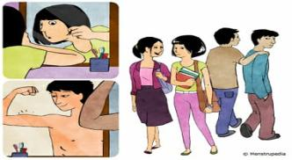
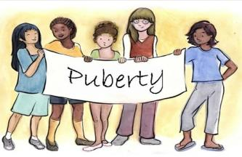
SEXUAL REPRODUCTION IN HUMANS
In humans, reproductive system becomes functional at a definite age called puberty. Males attain puberty at the age of 13-14 years while in female at the age of 10-12 years.
Changes that take place at the age of puberty
In Females
Hips get rounded
Mammary glands develop
Ovaries start producing eggs
Hormone estrogen produced by ovaries cause these changes.
In Males
Deep voice
Hair growth on body
Testes start producing sperm
Hormone testosterone produced by testes cause these changes.

Slide 15

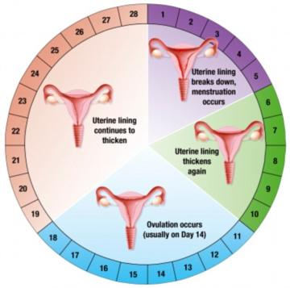
Menstruation
It is a cycle of bleeding or a series of changes in the ovary and the uterine wall of a non-pregnant female at the interval of 28 days on an average. The onset of menstruation at puberty is termed as Menarch. The stoppage of menstruation is called Menopause. It occurs at the age of 50 years and the ability of women to bear children stops.
A typical menstruation cycle
Day 1-5: Menstruation occurs while various hormone activate the formation of an egg in the ovary.
Day 6-13: The egg continues to be formed where the lining of the uterus is being prepared to receive it.
Day 14: Around 14th day the egg is released from the ovary.
Day 15-28: If the egg is fertilised, it implants itself in the wall of the uterus. But if the egg is not fertilised, blood vessels in the wall of the uterus shrink, become oxygen deprived, breakdown and move out of the vagina in the form of bleeding called menstrual flow. It lasts for about 4-7 days.

Slide 16

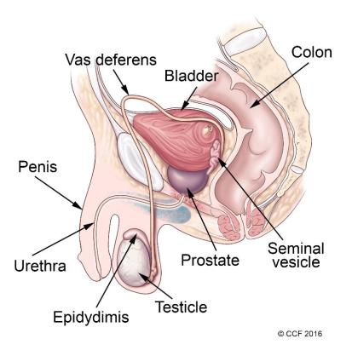
MALE REPRODUCTIVE SYSTEM
Human males have sex organs that are outside the body.
Penis: It is located in front of the body between the legs. It provide means of urination and sexual function.
Scrotum: It is a sac that is made of skin containing testicles. It holds the testes outside the body and provides optimal temperature for the formation of sperms. This temperature is 1-3⁰C lower than the temperature of the body.
Testicles: The testicles also called testes are male sex glands located in the scrotum. They produce and store sperm.
Epididymis: It is a long coiled tube that connects to the vas deferens. It stores sperm and transports it from the testes.
Vas deferens: It is a tube that carries sperm from the epididymis to the urethra.
Urethra: It is a tube that goes from the urinary bladder, through the penis, to the outside body.

Slide 17
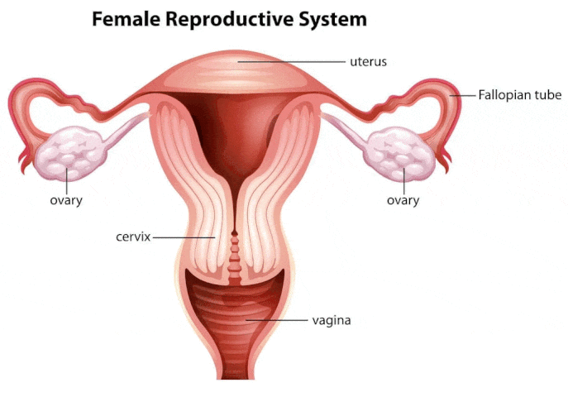
FEMALE REPRODUCTIVE SYSTEM
The organs of the female that are directly involved in the reproduction are located inside her body.
Ovaries: An organ which produce and release eggs. Female hormones like estrogen and progesterone are produced here.
Oviduct / Fallopian tube: A fine tube which carry the eggs from ovaries to the uterus.
Uterus: It is a muscular organ with an inner layer of spongy tissues where the fertilised egg develops.
Cervix: It is a ring of muscles that acts as an opening point into the uterus, where sperm can reach the eggs and can lead to fertilisation.
Vagina: A muscular tube which leads to the outside of the body.

Slide 18

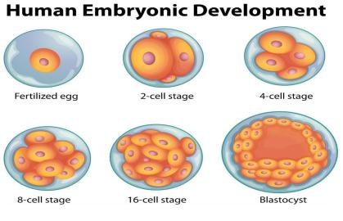
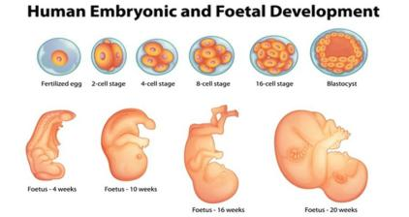
DEVELOPMENT IN HUMAN BEINGS
Fertilisation: During sexual intercourse, the penis releases millions of sperms into the vagina. Out of millions of sperms on reaching vagina, only few of them are able to swim with the help of their tail, reach the fallopian tube and the rest die. It there happens to be an egg in the fallopian tube or oviduct, it gets fertilised by just one single sperm and converts into zygote.
Implantation: The zygote soon undergoes a series of cell division and when it reaches the uterus it has already been formed into a small ball of cells called blastocyst. When this embryo sticks to the wall of the uterus. This process is called implantation and results in pregnancy. The implantation is complete in about 10 days after fertilisation.
Gestation: The complete development of the embryo from implantation to a full grown baby lasts for 280 days or 40 weeks. This period is called gestation period.
Parturition: When the baby is fully developed, the wall of the uterus contracts to expel the baby out through the vagina. This is called parturition.

Slide 19

Thank you students!

