Slide 1


Good Morning Students!
Our lesson today is on
REPRODUCTION

Slide 2
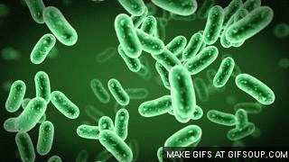
Reproduction in Plants and Animals

Slide 3
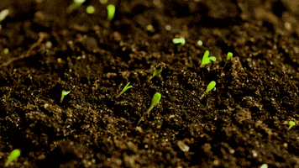
Reproduction
Reproduction is the process by which old organism give rise to a new organism of its own kind. For example, a cat produces kittens which grow into adult cats. Amoeba, paramecium and many other microorganisms just split into two more individuals.

Slide 4
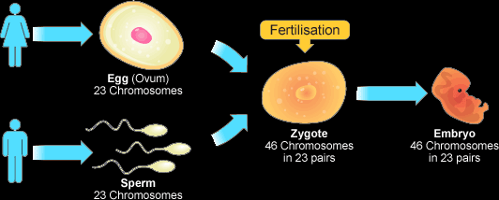
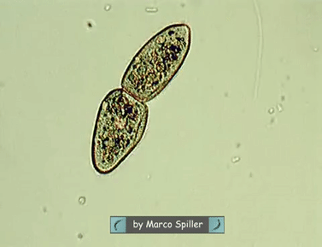
Types of Reproduction
i) Asexual reproduction: It is a type of reproduction in which a new organism develops from structures produced by one parent. Off-spring produced are genetically identical to the parents.
ii) Sexual reproduction: It is a type of reproduction in which new organism develops from two gametes (sex cells) that have joined together.

Slide 5
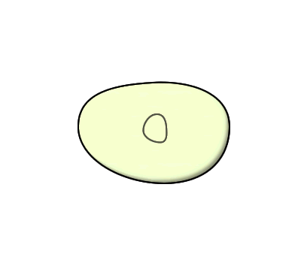
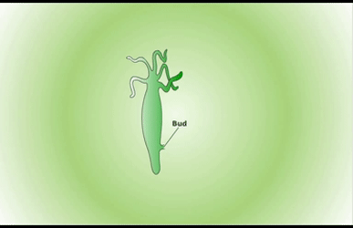
Asexual reproduction in plants
Binary fission: It is a simple division of unicellular organisms into two similar daughter cells of roughly equal size, exactly identical in shape. E.g. bacteria, some algae and fungi.
Budding: A new individual arise on the parent organism as an outgrowth called bud.

Slide 6
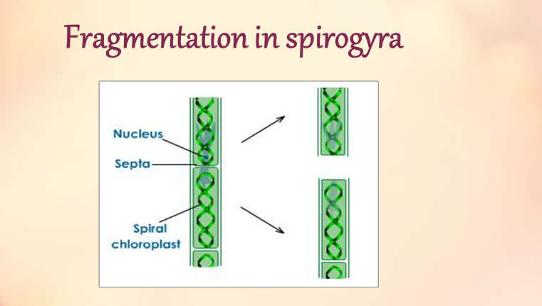
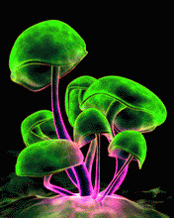
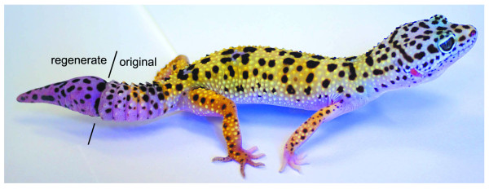
Fragmentation: In Spirogyra, the filaments break-up into two or more fragments upon maturation. These fragments grow into new individuals.
Spore formation: In this type of reproduction, small bodies called spores are formed. These spore germinate to form a new organism.
Regeneration: The ability of plants and animals to repair themselves or grow their lost part is called regeneration.

Slide 7
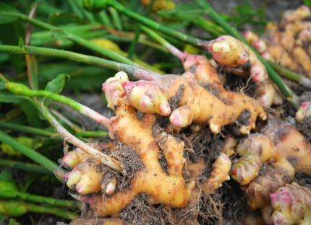
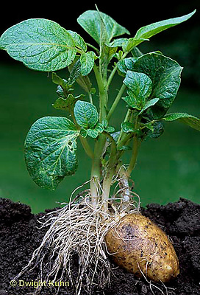
Vegetative propagation
It is the process of reproduction of new plants from any vegetative part of the plant.
Natural methods of vegetative propagation:
a) Rhizome: An underground stem, has buds. E.g. bamboo and ginger.
b) Tuber: An underground stem, has small buds called eyes, has supply of stored food. E.g. Potato, Artichoke

Slide 8
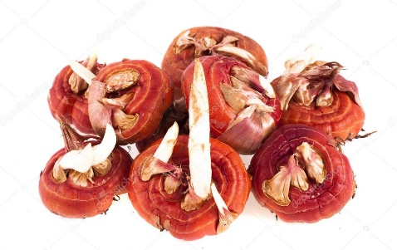
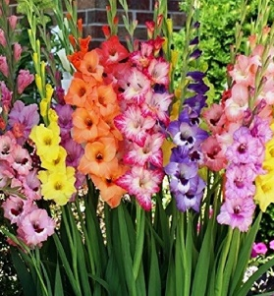
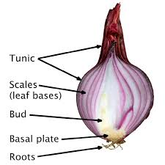
c) Corm: A short stem, with stored food. Corm separate and form new plants.
d) Bulb: Terminal bud gives rise to the floral shoots. E.g. Gladiolus, Colocasia propagation by leaves

Slide 9
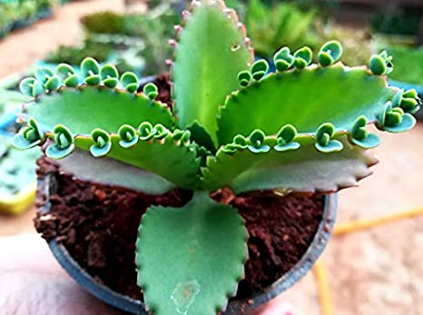
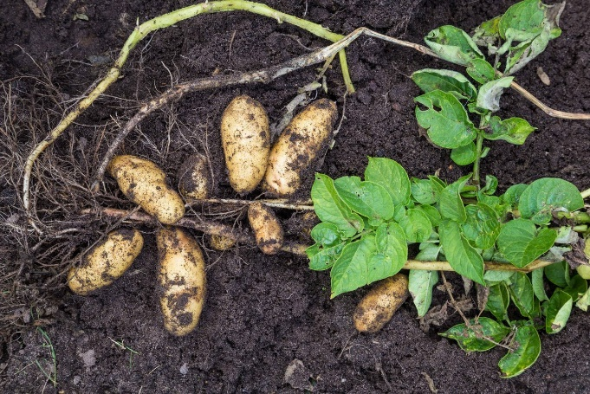
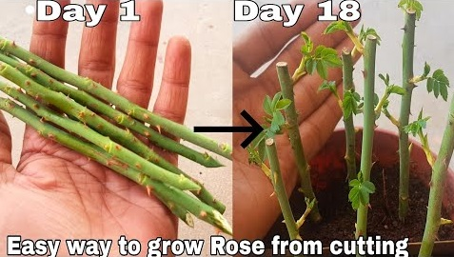
e) Vegetative propagation by leaves, roots and stems: Bryophyllum bears small buds at the margin of leaves, from which new plant arise.
Sweet potato bears buds which give rise to new plants.
In sugarcane, rose a new plant can be grown by
planting stem cuttings.

Slide 10
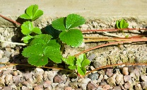
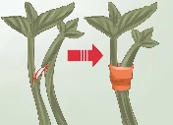
Artificial methods of vegetative propagation
Man-made methods to grow many plants from one plant at a much faster rate.
The major artificial methods are:
Cutting: rose, carnations
Layering: strawberry, orange
Grafting: mango, apple
Budding: yeast

Slide 11
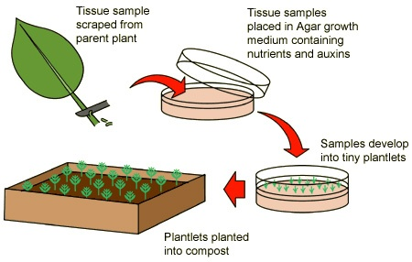
e) Tissue culture: Production of plants by cells or tissues or organs in synthetic medium.

Slide 12
Steps in tissue culture
Callus stage: tissue is grown in nutrients (sugar, salts, pH etc) medium till it forms an unorganised mass called callus.
1
Plantlet stage: The callus are transferred to fresh agar. This fresh agar contains a hormone to promote root and stem , growth forming plantlets.
2
Maturity stage: When plantlets form, they are planted into potting compost where they grow to maturity.
3

Slide 13
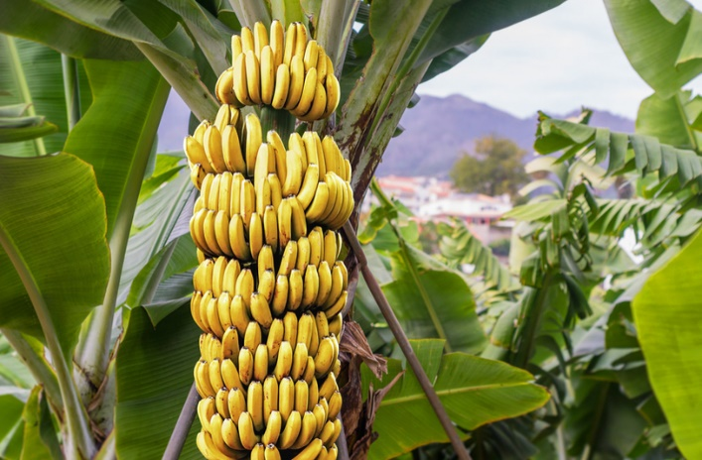
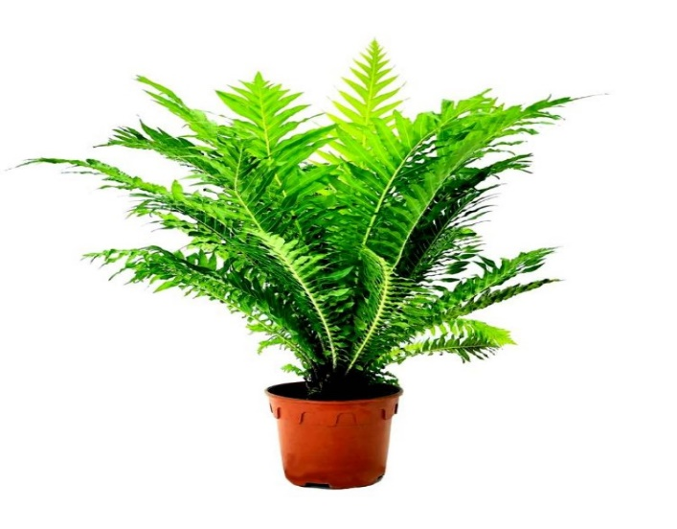
Advantages of Vegetative propagation
Plants bear flowers and fruits earlier than those produced from seeds.
Seedless plants can be produced.
Daughter plants are exact copies of the parent plant and show no variation. E.g. banana, sugarcane etc
Plants need less attention in early stages than plants grown from seeds.

Slide 14
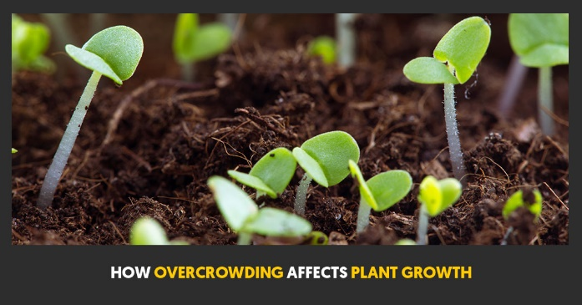
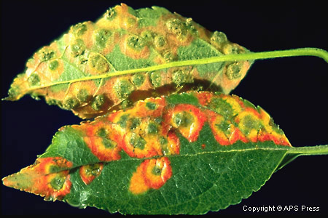
Disadvantages of Vegetative Propagation
It causes overcrowding and causes competition.
Plants cannot be stored for long period of time.
Disease contacted from parent spread to all daughters.
Unable to adapt themselves to change in environment.

Slide 15
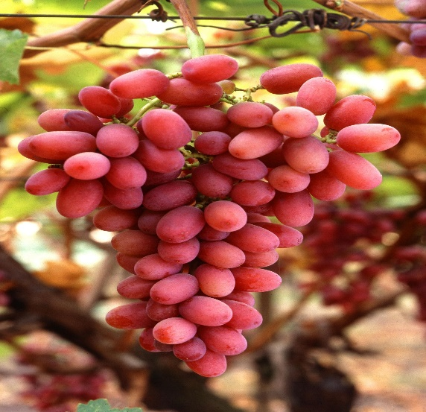
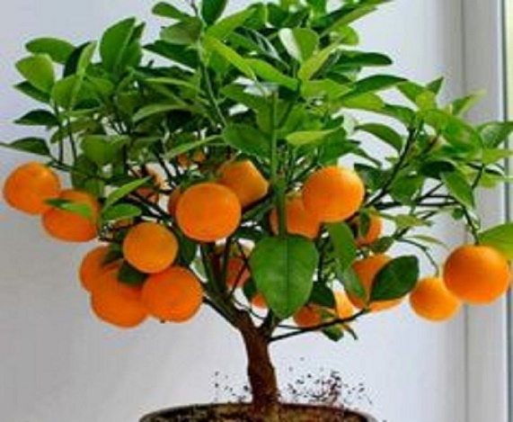
Economic importance of Artificial Propagation
Seedless plants can be produced. E.g. grapes, pineapple, orange, rose etc.
Taste of many citrus fruits can be improved. Example: lime, orange,
Disease resistant plants can be produced.

Slide 16
Thank you students!

