Slide 1
Chapter 1
Hardware Components of a Computer System

Slide 2
Computer System
Hardware Components
Software Components
All the physical parts that can be seen and touched
These are programs that instruct a computer to do different tasks
Both HARDWARE and SOFTWARE are needed for a computer system to work properly

Slide 3
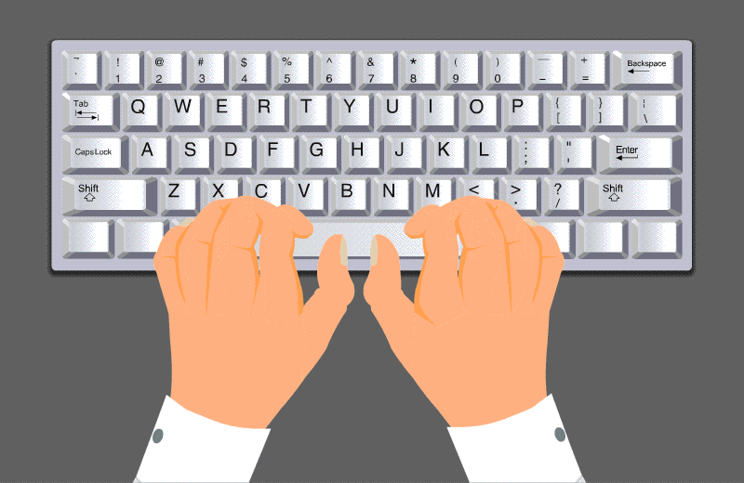
So what are the different types of Hardware Components?
External hardware components
Internal hardware components

Slide 4
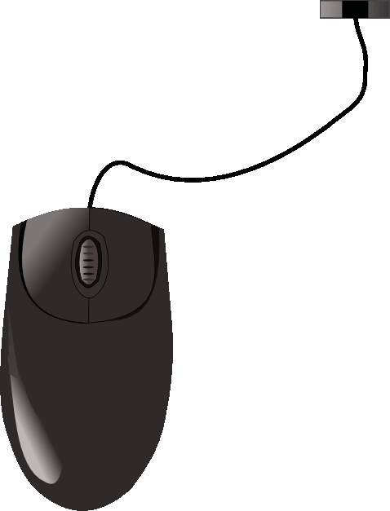
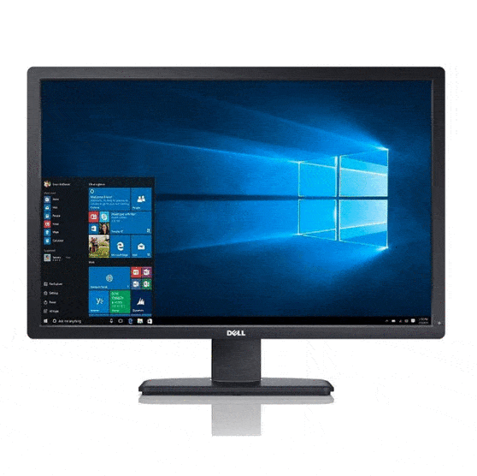
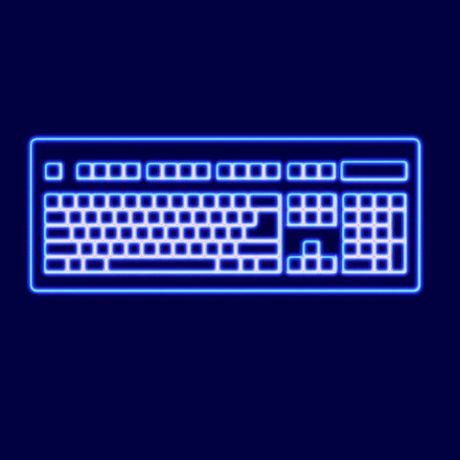
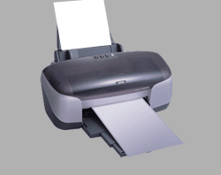
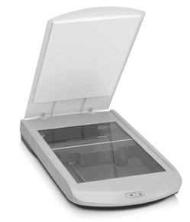
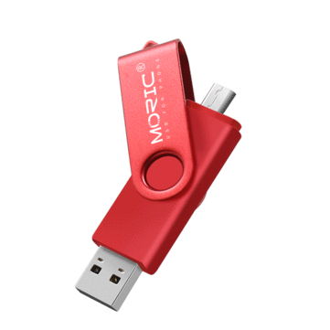
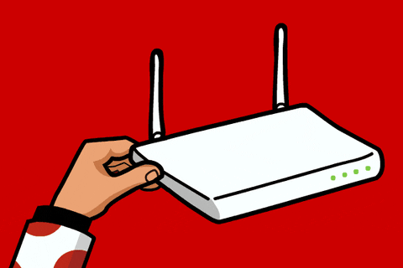
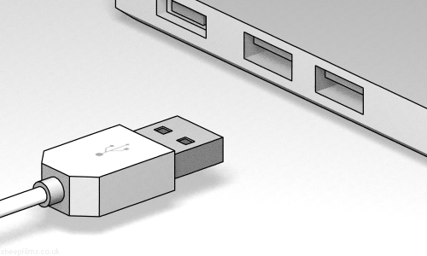
Examples of External Hardware Components
Monitor
Keyboard
Mouse
Printer
Scanner
USB Flash Drive
Modem
Port

Slide 5
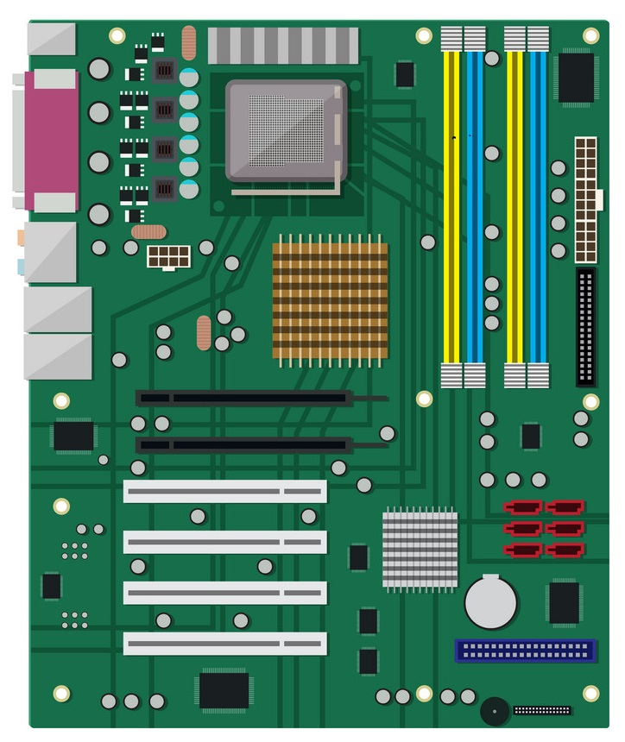
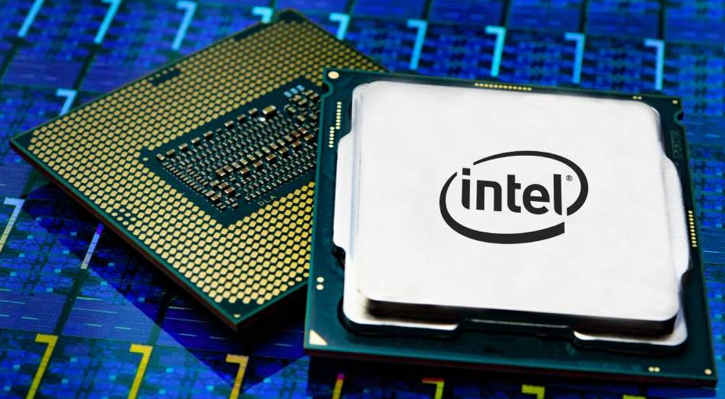
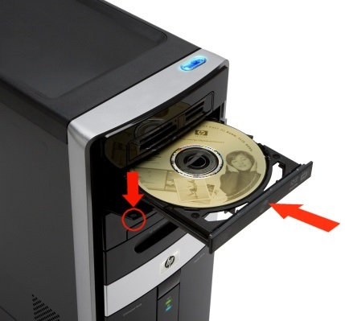
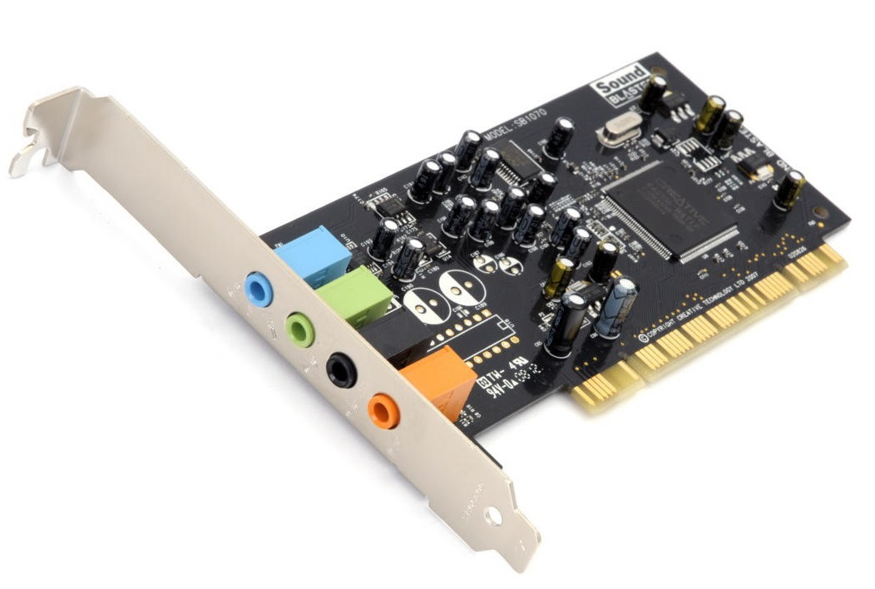
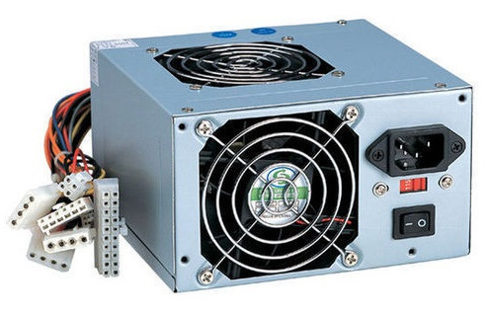
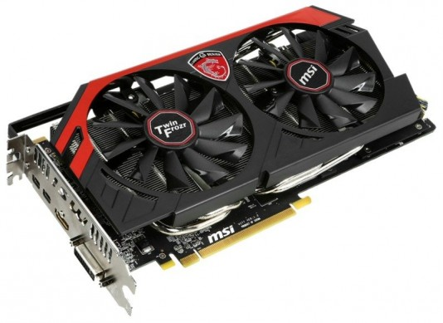
Examples of Internal Hardware Components
Mother Board
Processor
Disk drive
Sound card
Graphics card
SMPS

Slide 6
Difference between EXTERNAL and INTERNAL hardware components
External Components
Internal Components
These are attached to a computer externally.
These are inside a computer.
These components can be easily detached from a computer and carried from one place to another.
These components are not carried from one place to another.
They are connected to a computer with the help of wires or cables.
They are connected to the motherboard of a computer.
Some examples are monitor, keyboard, mouse, pen drive and so on.
Some examples are motherboard, processor, disk drive, sound card and so on.

Slide 7
Thank you students!

