Slide 1
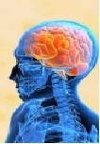
NERVOUS SYSTEM
Class – 7
Subject – BIOLOGY
Part - 1

Slide 2
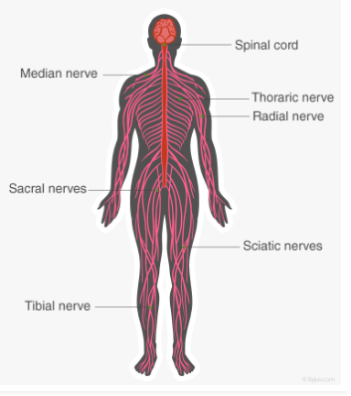
Definition of Nervous System
The system that controls and co-ordinates all the activities of various body parts in response to external and internal stimuli by the conduction of nerve impulses is called Nervous System.

Slide 3
Three main Parts of Nervous System
Central Nervous System (CNS)

Slide 4
Three main Parts of Nervous System
Central Nervous System (CNS)
Peripheral Nervous System (PNS)

Slide 5
Three main Parts of Nervous System
Central Nervous System (CNS)
Peripheral Nervous System (PNS)
Autonomic Nervous System (ANS)

Slide 6
Three main Parts of Nervous System
Central Nervous System (CNS)
Peripheral Nervous System (PNS)
Autonomic Nervous System (ANS)
C N S
BRAIN
SPINAL CORD

Slide 7
THE BRAIN
STRUCTURE –
The human brain is a greyish-pink ball with many ridges on its surface.
LOCATION –
Brain is connected with the rest of the head by cranial nerves and with the body through the spinal cord. The brain is found inside a part of the skull called cranium.
The brain is covered by three membranes called meninges, having a fluid called cerebrospinal fluid (CSF) in between them. The fluid protects the brain from mechanical shocks.

Slide 8
The Brain is divisible into three regions:
BRAIN
Forebrain
Midbrain
Hindbrain

Slide 9
The Brain is divisible into three regions:
BRAIN
Forebrain
Midbrain
Hindbrain
CEREBRUM
Hypothalamus
OLFACTORY
LOBES

Slide 10
The Brain is divisible into three regions:
BRAIN
Forebrain
Midbrain
Hindbrain
PONS
CEREBELLUM
MEDULLA
OBLONGATA

Slide 11
The Brain is divisible into three regions:
BRAIN
Forebrain
Midbrain
Hindbrain
CEREBRUM
PONS
Hypothalamus
CEREBELLUM
OLFACTORY
LOBES
MEDULLA
OBLONGATA

Slide 12
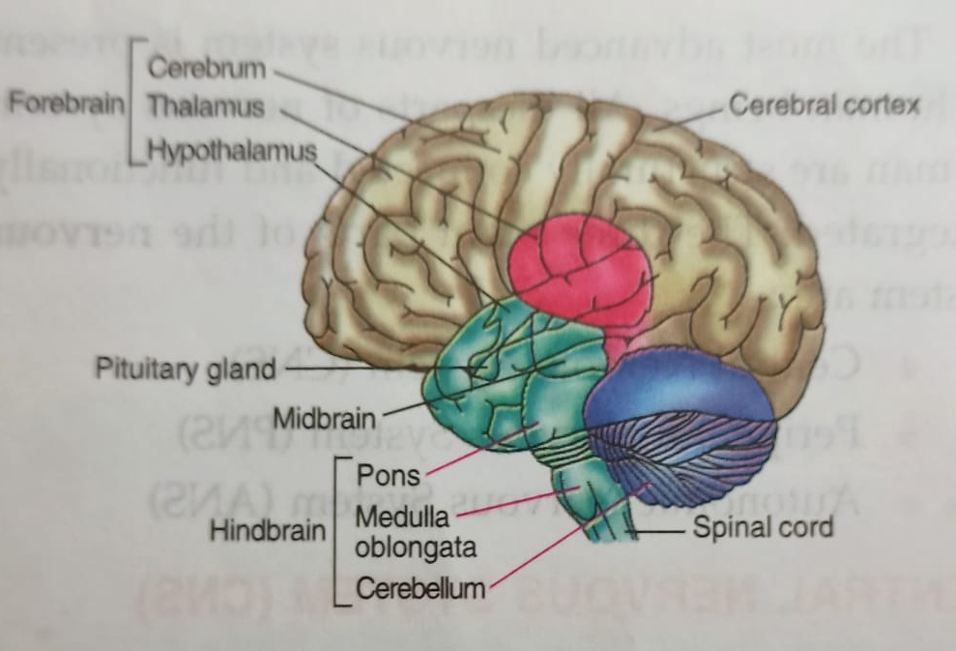
The main parts of the Human Brain

Slide 13
Forebrain:
It is differentiated into:
1. Cerebrum
2. Hypothalamus
3. Olafactory lobes.
1. The Cerebrum :
It is the largest and most complex part of the brain.
BRAIN TISSUES
Cerebral Medulla
White matter is composed of mainly axons or fibres and form deeper part
Cerebral Cortex
grey matter and consist mainly of neurons or cell bodies

Slide 14
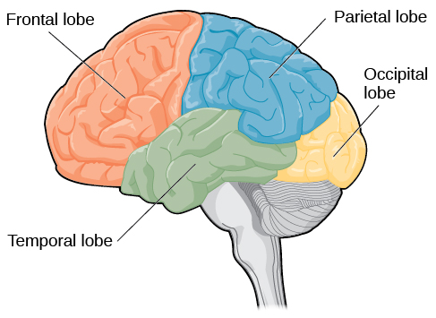
Various types of lobes present in
the brain
The frontal lobe controls voluntary movements, personality, speech and memory.
The parietal lobe is involved with a wide variety of sensory information - heat, cold, pain, touch and body position in space.
The occipital lobe contains our sense of vision.
The temporal lobe contains our sense of hearing.

Slide 15
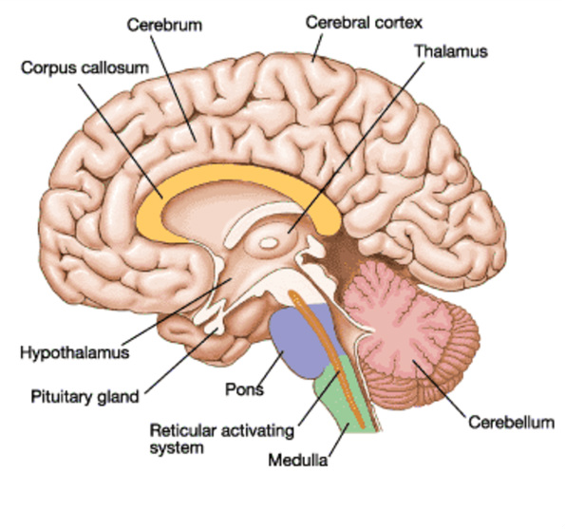
Activity 1: To understand the various parts of the brain along with some of their functions
Cerebrum – The largest part of the brain, divided into the left and right cerebral hemispheres..
Hypothalamus – monitors the temperature of the blood.
Pituitary gland – It is the master gland.
Cerebellum – Controls posture, coordination of movement and the position of the body in relation to its surroundings.
Pons – Helps to control breathing movements.
Medulla oblongata – Controls heart-beat, blood pressure and breathing movements.

Slide 16
Functions of Cerebrum:
The important functions performed by cerebrum are:
It is the seat of memory, will power, emotions, experiences, intelligences, reasoning, learning, etc.
It perceives the sensory impulses such as pain, temptation, touch, taste, smell hearing and sight.
It controls the conscious sensations and all voluntary actions.
Subconscious or unconscious mind is also located in the cerebrum.
2. Hypothalamus:
It maintains body temperature.
3. Olfactory lobes:
These are the pairs of lobes which are concerned with sense of smell.

Slide 17
End of Part – 1.

