Slide 1
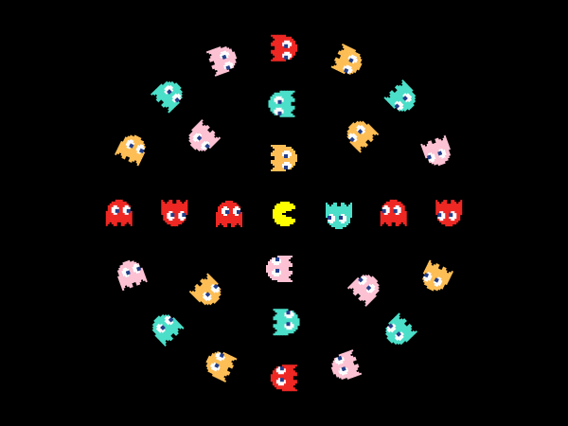
Chapter 2
Malicious Software

Slide 2
Computer Programs
When we use a computer, we instruct it to perform tasks by using computer programs. Many of these programs make our work easier. However, there are some harmful programs that can damage the data stored on our computer. All such programs are termed as malicious software or malware.
Malware
MALICIOUS
SOFTWARE
Software programs such as computer viruses, worms, trojans, spyware, sweeper and adware are examples of malware

Slide 3
What is Computer Virus?
A computer virus is a type of malware. People create malware for the purpose of making money, stealing your information or simply to be annoying. A virus can enter a computer without the knowledge of its user.

Slide 4
What does a Computer Virus do?
It can corrupt or delete data on a computer.
It can erase everything on the hard disk of a computer.
It can steal the personal, financial or business information.
It can take the control of user’s computer for illegal purposes.
It can send emails without knowledge.
It can use an email program to spread itself to other computers.
It can spread to other machines on the same network.

Slide 5
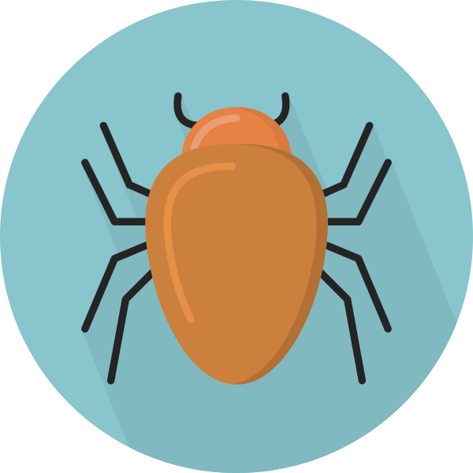
Symptoms of a Virus Attack on a Computer
Unusual messages start appearing on the screen.
The speed of the computer decreases.
Files are deleted or damaged. The data on the system becomes inaccessible.
The software or operating system seems to be changed.
Automatic rebooting or restarting of the computer system.
Random appearance of blank blue screen on the monitor.
Random playing of strange sounds.

Slide 6
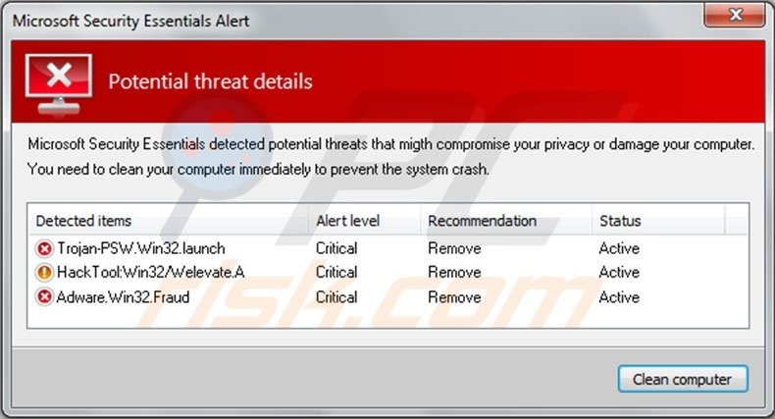
The picture below shows virus that has infected a computer

Slide 7
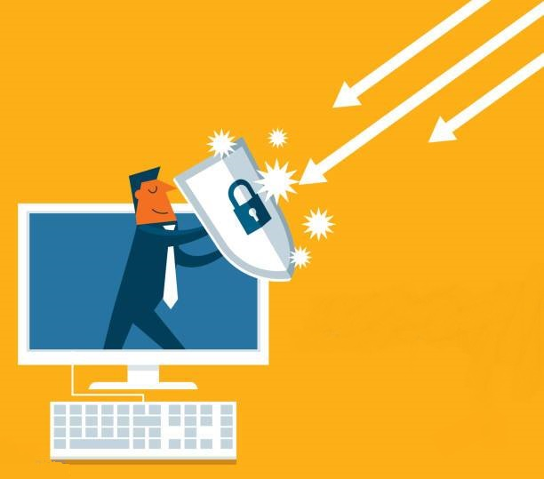
How to prevent virus infections?
Install a program called antivirus on your computer to detect and delete viruses.
Update the antivirus software on a regular basis.
Always use a CD or a USB flash drive received from a trustworthy source.
Always scan USB flash drives, memory cards, CDs and DVDs before accessing.
Always scan programs or files downloaded from the Internet.
Do not open or download files attached in emails received from unknown source.
Immediately delete the suspected email.
Use a strong password for your computer to avoid access by unknown people.
Do not click on the links of unknown websites while surfing the Internet.

Slide 8
TYPES OF COMPUTER VIRUSES
1. Boot sector virus: it resides in the hard disk drive. A boot sector virus copies its infected code into the code of the boot sector. The infected code then gets loaded and runs at the time of booting (starting) the computer. Examples: Elk Cloner and Brain.
2. File infector virus: this virus infects program files or executable files. It either deletes or damages files in your computer system. Examples: Cascade and Sunday.

Slide 9
3. Macro virus: A macro virus is a computer virus written in the same macro language used for software programs such as Microsoft Word and Excel. When a macro virus infects a software application, it causes a sequence of actions to begin automatically when the application is opened. Examples: Nuclear and DMV.
4. Polymorphic virus: It is a virus that changes its code every time it infects a new file. So it can have hundreds of different forms. Its purpose is to slow down the computer. It is the most dangerous virus because it is difficult to detect. Examples: Elkern and Marburg.

Slide 10
5. Trojan Horse: it is a program that appears to be safe but damages the computer once it runs. It can spread only when it is copied to another system. It can damage files, break passwords and make unauthorized transfers of money or unnecessarily download or upload files. Examples: Acid Rain and Crack.
6. Worm: it is a program that copies itself from one computer to another or over a network without human assistance. Unlike a virus, a worm is capable of running itself and does not need a host program. Worms can modify and delete files, and they can even inject additional malicious software onto a computer. Examples: Slammer Worm and Storm.

Slide 11
7. Spyware: it is a type of malware designed to collect information about the Internet surfing habits and frequently visited websites by the user. On the basis of websites visited by the user, advertisements start appearing on the screen of the computer in the form of banners and pop-ups. Example: Look2Me.
8. Sweeper: it is a type of spyware that is difficult to detect and remove. It re-installs itself even after it is removed from a computer. Computers may get infected by a sweeper virus while downloading a software.

Slide 12
9. Adware: the word adware has been formed from the words – Advertising Supported Software. Adware is used to display advertisements in the form of banners, pop-ups and unclosable windows in the infected computer.
10. Backdoor virus: it is a program that runs in the background of another file without the knowledge of the user. It is designed to gain access to a computer over a network. Backdoors get installed in a computer when a user downloads huge files from the Internet. Examples: Subseven and NetBus.

Slide 13
Antivirus software is a set of programs that are used to detect and remove viruses and other malware from a computer. It searches for viruses in all files and folders of the computer system and removes them.
Some antivirus software are freely available on the Internet such as Avira Free, AVG Free, Bitdefender, Panda Cloud and so on.
Some antivirus software has to be purchased. Examples include McAfee, Kaspersky, Avast, Norton, Quick Heal and Malwarebytes.
A FIREWALL is a software program used to protect a computer from hackers, viruses and worms that try to infect it over the Internet.

Slide 14
How an Antivirus Software Works:
1
3
When a file is totally damaged or infected by dangerous viruses then the antivirus decides to delete it.
QUARANTINING
DELETING
Quarantining a file is usually the first action that an antivirus software takes when it detects a virus. If an infected file is put in quarantine, it is deleted from its original location and it can no longer infect your computer.
2
The antivirus removes the virus code and restores the file to its original form. This is better than quarantining.
REPAIRING

Slide 15
THANK YOU STUDENTS!

