Slide 1
Chapter 5:
An Introduction to Excel

Slide 2
Microsoft Excel is a spreadsheet developed by Microsoft. It is part of the Microsoft Office suite of programs that includes:
What is Excel?
Microsoft Word
Outlook
Power
Point
OneNote
Access

Slide 3
Microsoft and Bills Gates
Microsoft Corporation is an American multinational technology company with headquarters in Redmond, Washington. It develops, manufactures, licenses, supports, and sells computer software, consumer electronics and personal computers.
Microsoft was founded by Bill Gates and Paul Allen on April 4, 1975, to develop and sell BASIC interpreters for the Altair 8800.

Slide 4
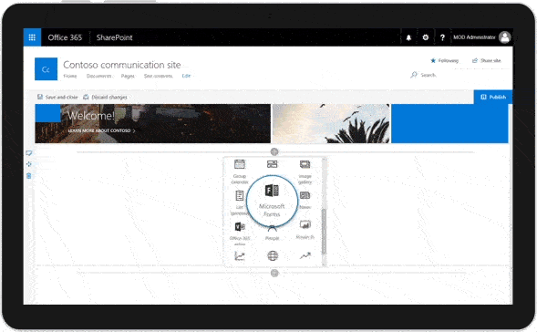
Where can you get Microsoft Excel?
There are number of ways in which you can get Microsoft Excel:
You can buy it from a hardware computer shop that also sells software.
Alternatively, you can download it from the Microsoft website but you will have to buy the license key.

Slide 5
Why do we use Excel?
We all deal with numbers in one way or the other. We all have daily expenses which we pay for from the monthly income that we earn. For one to spend wisely, they will need to know their income vs. expenditure. Microsoft Excel comes in handy when we want to record, analyze and store such numeric data.

Slide 6
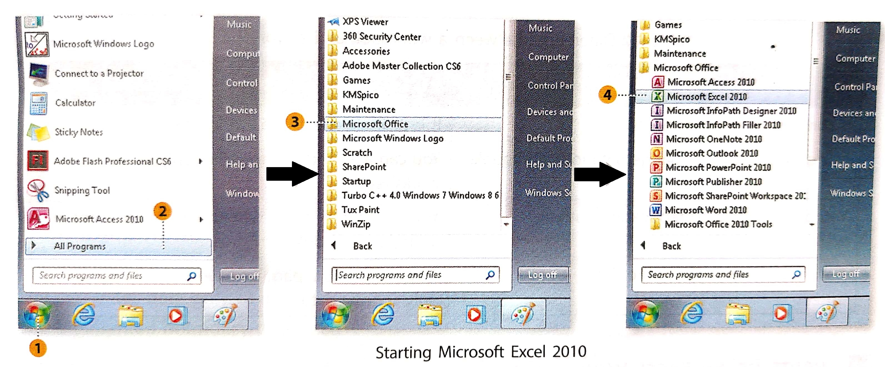
Starting MS Excel 2010…..
To start Microsoft Excel 2010, follow these steps:
1. Click on the start button
2. Click on All Programs
3. Click on Microsoft Office
4. Click on Microsoft Excel 2010
The Excel window opens to display a new file. An Excel file is called a workbook. An Excel workbook is like a notebook. Just as a notebook consists of pages, a workbook consists of worksheets. A worksheet has rows and columns where you enter data (information).

Slide 7
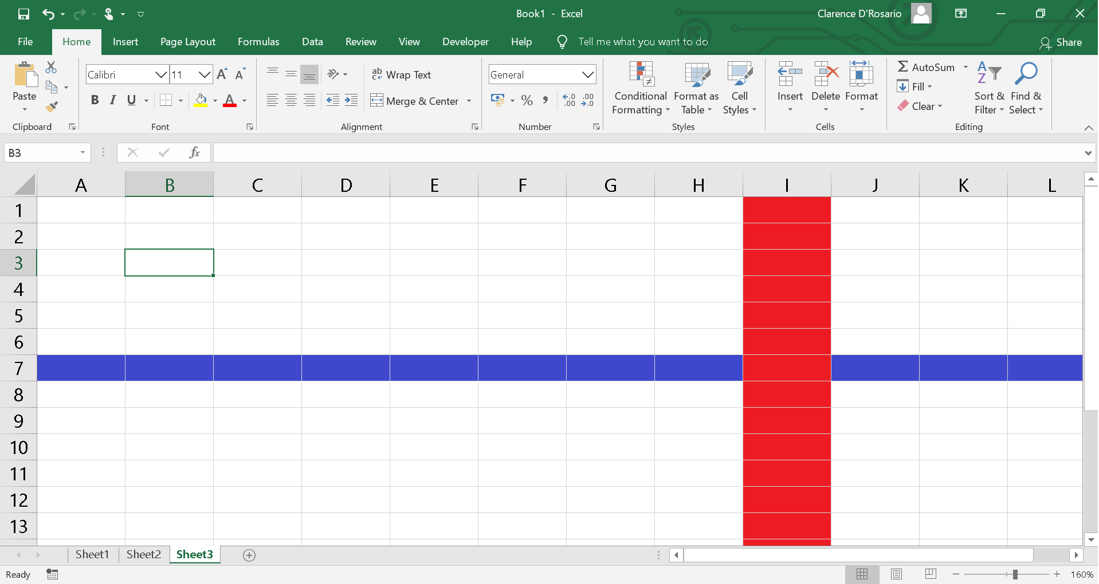
Key Parts of a Worksheet
Name Box
Formula Bar
Active Cell
Column Headings
Row Headings
Sheet tabs
Column i
Row 7

Slide 8
Differences between a Workbook and a Worksheet
WORKBOOK | WORKSHEET
1. It contains many worksheets. | 1. It is a single sheet of a workbook.
2. You cannot add and change data in a workbook. | 2. You can add and change data only in a worksheet.
3. You cannot add a workbook in another workbook. | 3. You can add as many worksheets as you want in a single workbook.
4. A workbook holds the entire data. | 4. A worksheet is a page in a workbook holding only specific data.

Slide 9
Rows, Columns and Cells
In an Excel worksheet, rows run horizontally and columns run vertically.
The intersection of a column and a row is called a cell. This is where you enter data.
So how do you identify a row and a column? Each row is identified by a number called row heading. Each column is identified by a letter called a column heading.
Row 7
Column I

Slide 10
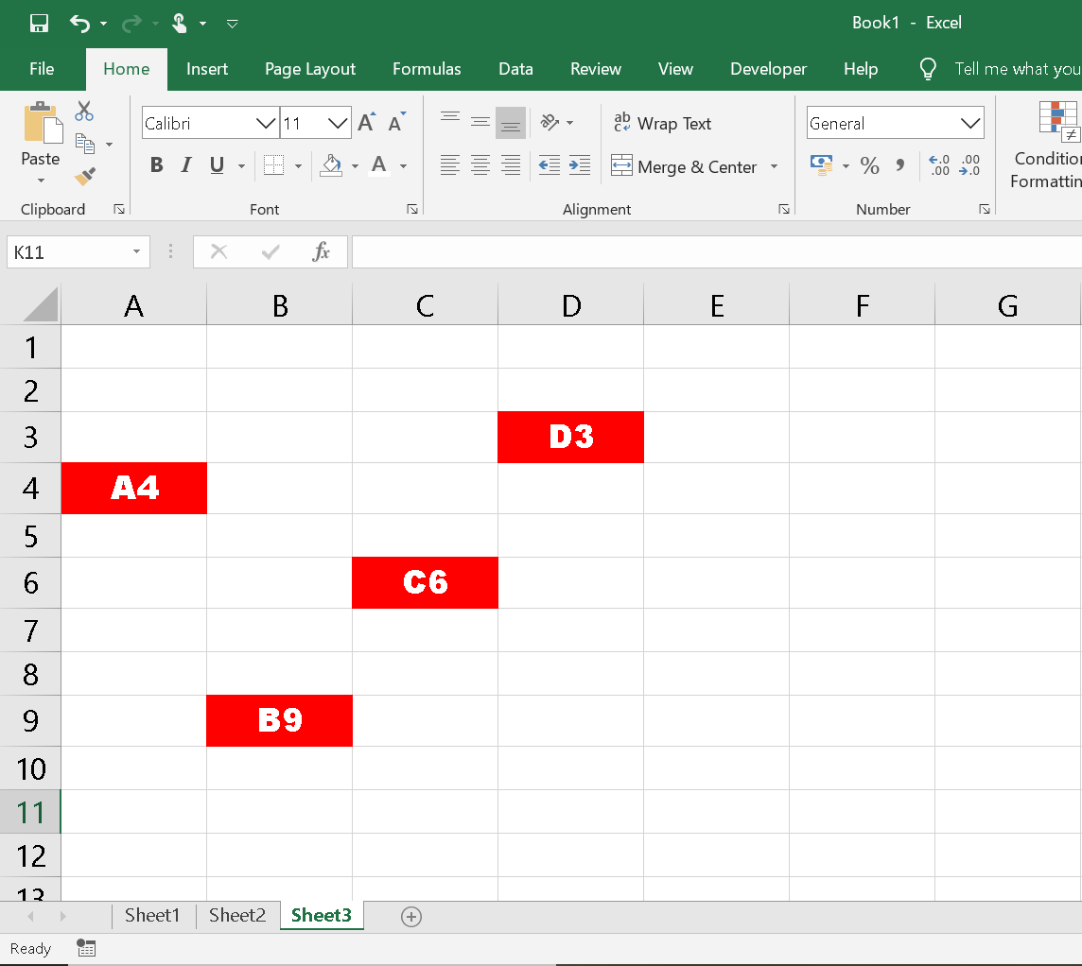
Cell Address
Each Cell in a worksheet has a unique address. This helps to differentiate between cells in a worksheet.
A column heading followed by a row heading creates a cell address. To understand this better take a look at the given diagram. The cell addresses are given inside the cells.

Slide 11
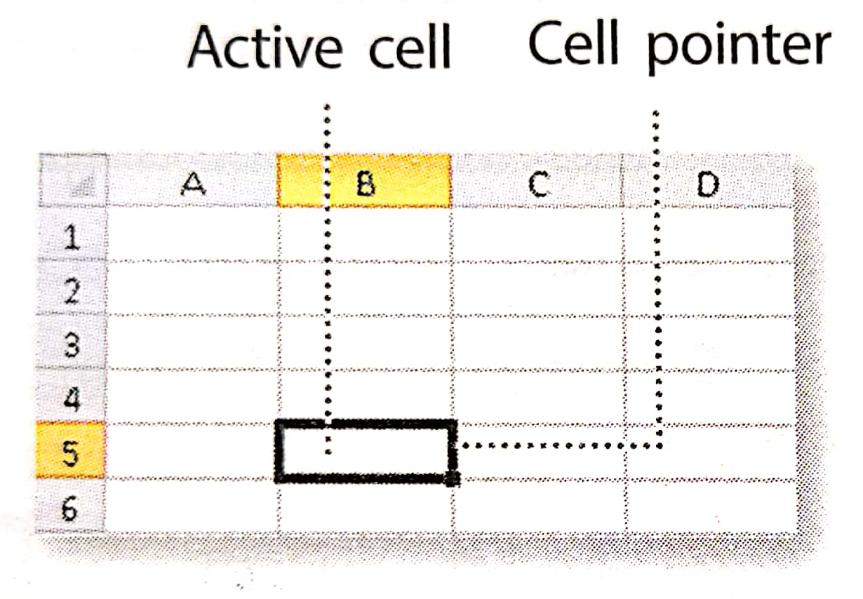
Active Cell
When you click on a cell, a thick black border appears along its boundary. This cell is now called an active cell. See the given diagram.
You can enter data only in an active cell.
The highlighted boundary of an active cell is called the cell pointer.

Slide 12
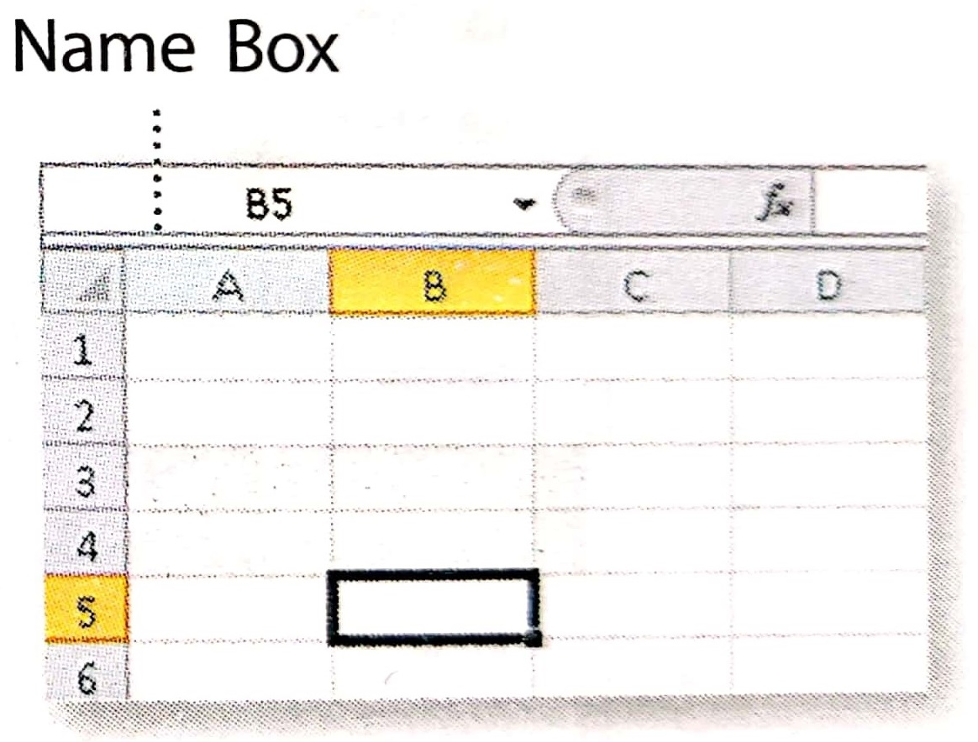
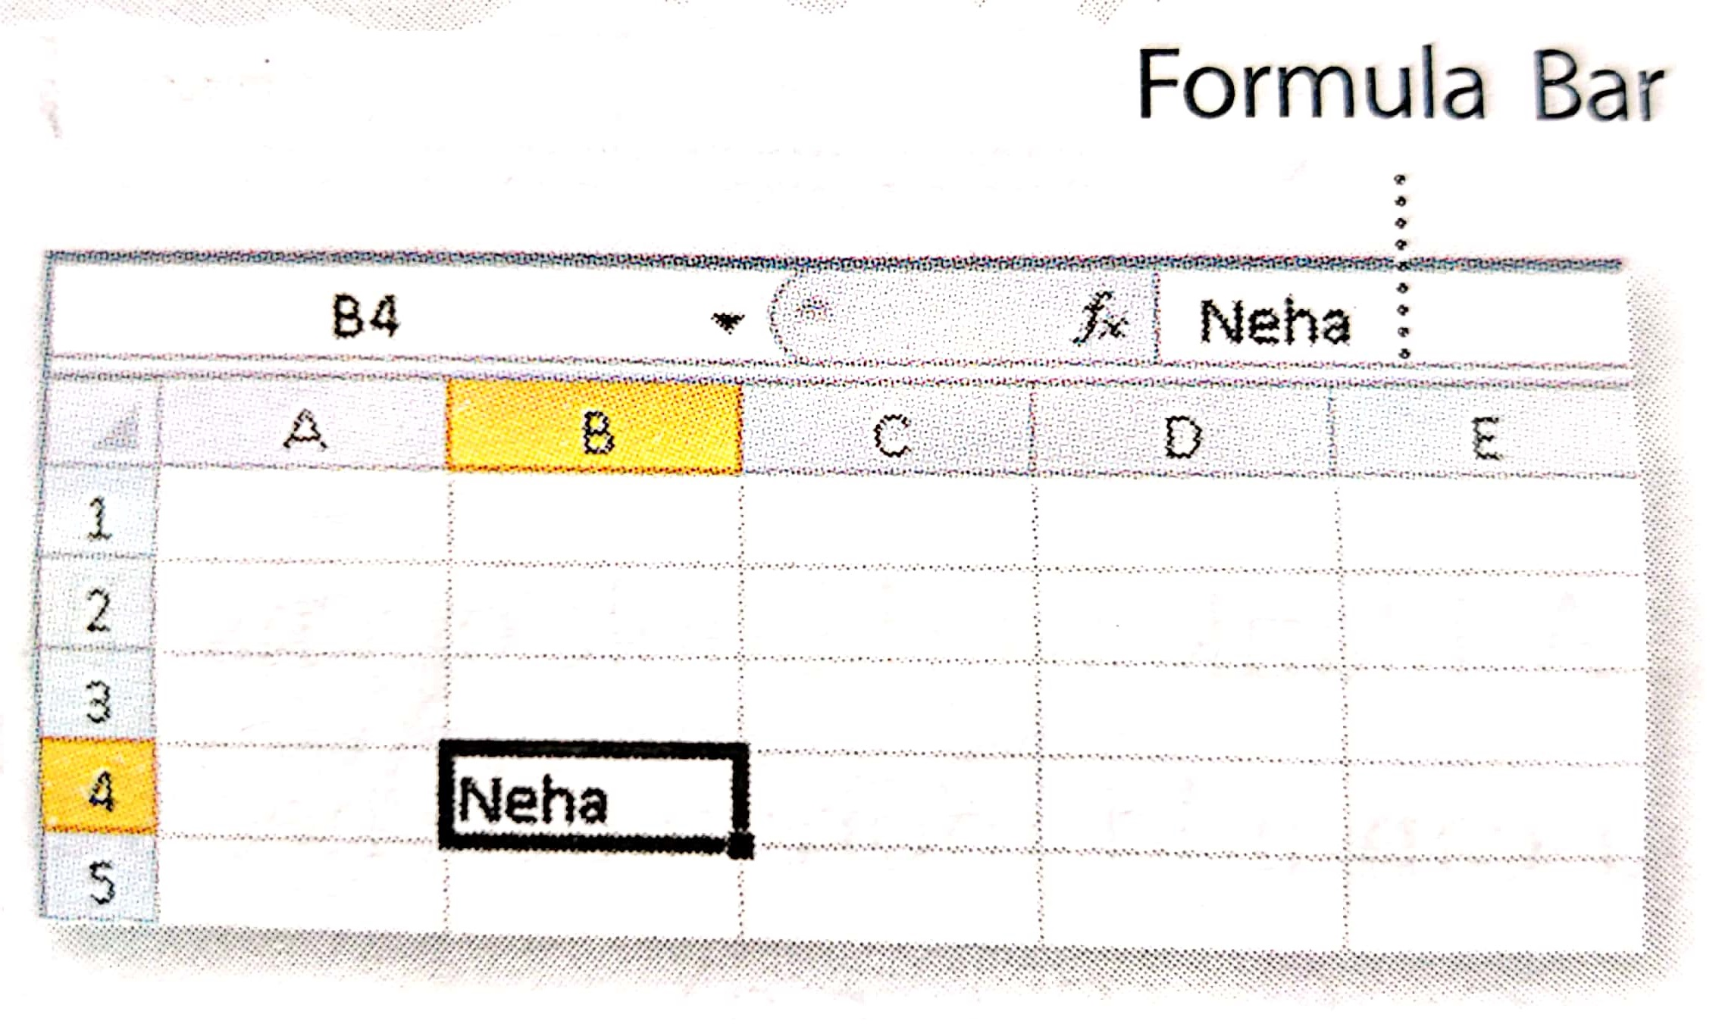
Name Box
Formula Bar
The Name Box displays the cell address of an active cell. The figure below shows the name box.
To go to a cell directly, you can type its cell address in the Name Box.
The Formula Bar displays the contents of the active cell. You can also click the Formula Bar to enter data into an active cell.

Slide 13
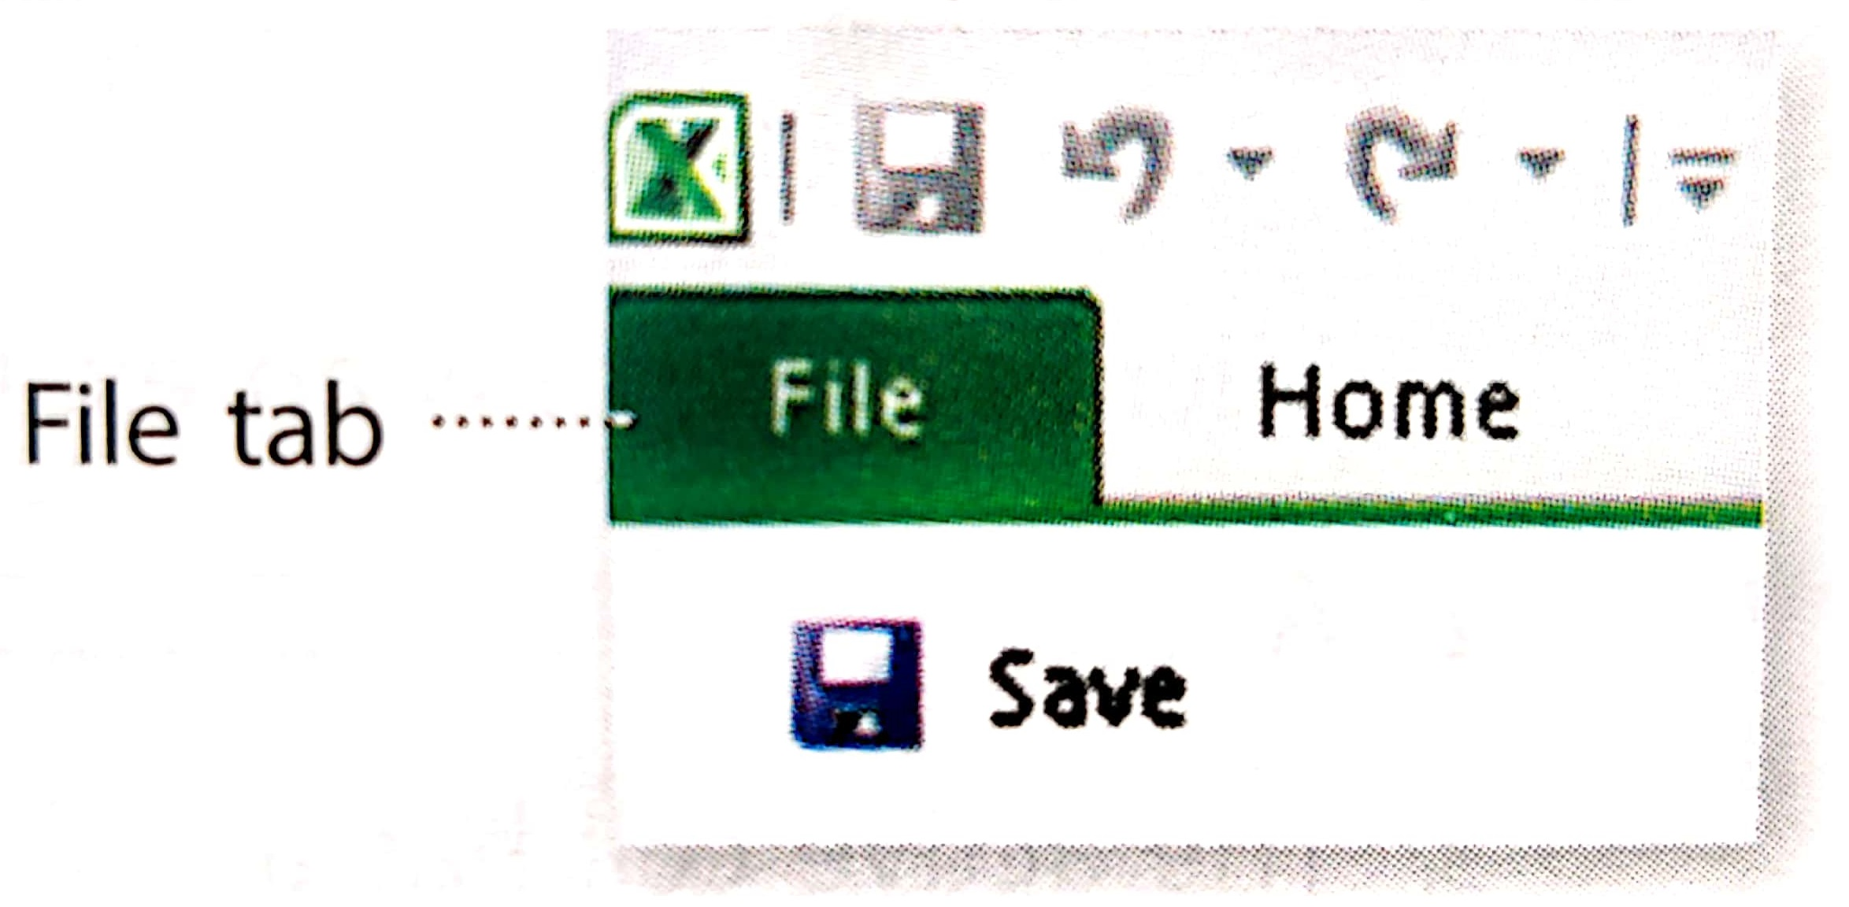
File Tab
The File tab is used to open new or existing worksheets. It is also used to save and print worksheets.

Slide 14
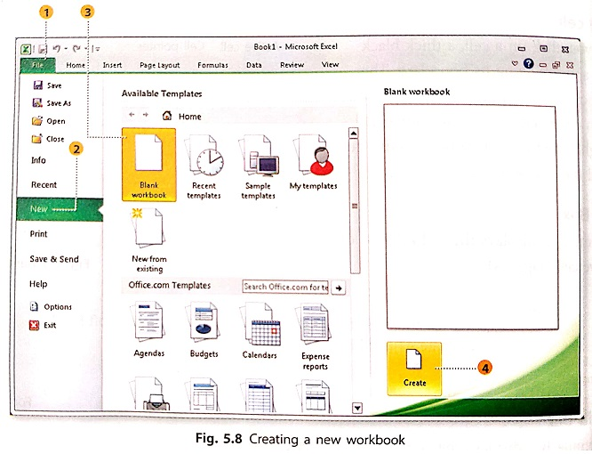
Creating a New Workbook
To create a new workbook, follow these steps:
Click on the File tab.
Click on New from the list that opens.
Click on Blank workbook.
Click on the Create button
A blank workbook opens. By default, there will be three worksheets in the workbook. You can add more worksheets if you need to. You can select any worksheet with the help of the Sheet tabs

Slide 15
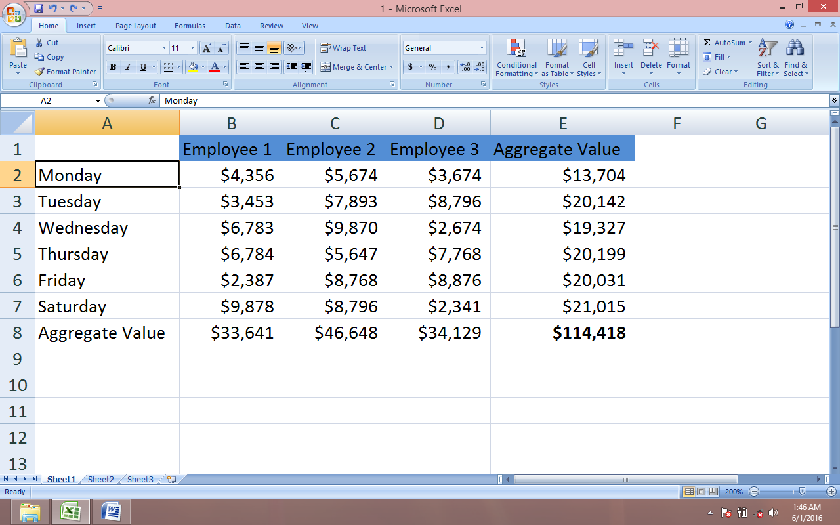
Entering Data in a Worksheet
To enter data in a worksheet, follow these steps:
Click on the cell where the data is to be entered and start typing.
After you finish typing, press the ENTER key. You will move to the cell below the active cell.
To move to the adjacent cell, press the TAB key.

Slide 16
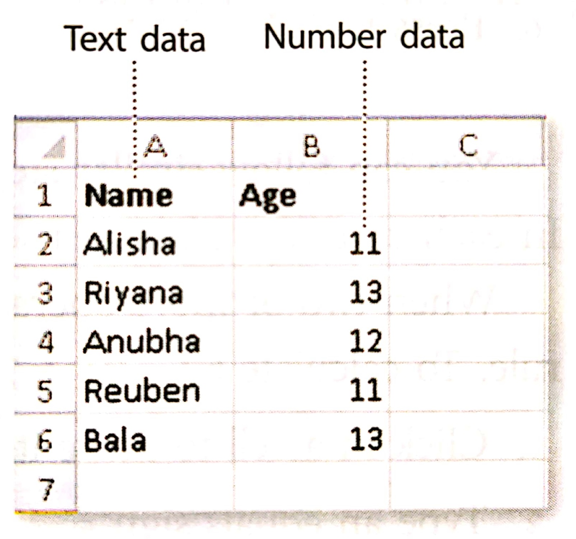
Types of data
You can enter three types of data into an Excel worksheet - text, numbers and formulas
Text: Text data can contain letters, numbers, spaces and special characters. Excel aligns text to the left of the cell.
Numbers: Numbers consist of numerals such as 0, 1, 2, 3 and so on. Excel aligns numbers to the right of the cell.
Special characters: Special characters are symbols such as =, $, ^, @ and so on. These are aligned to the left of the cell.
Formulas: Excel performs mathematical operations such as addition, subtraction, multiplication, average and percentage.

Slide 17
Performing Calculations
You can do mathematical operations such as addition, subtraction, multiplication and division in Excel. The operators used for doing calculations are listed in the table below:
OPERATOR | COMMAND IN EXCEL
Brackets | ( )
Order (Power) | ^
Divide | /
Multiply | *
Add | +
Subtract | -
Remember:
A formula starts with an equal sign (=).
Excel will calculate the sum as per the BODMAS rule.

Slide 18
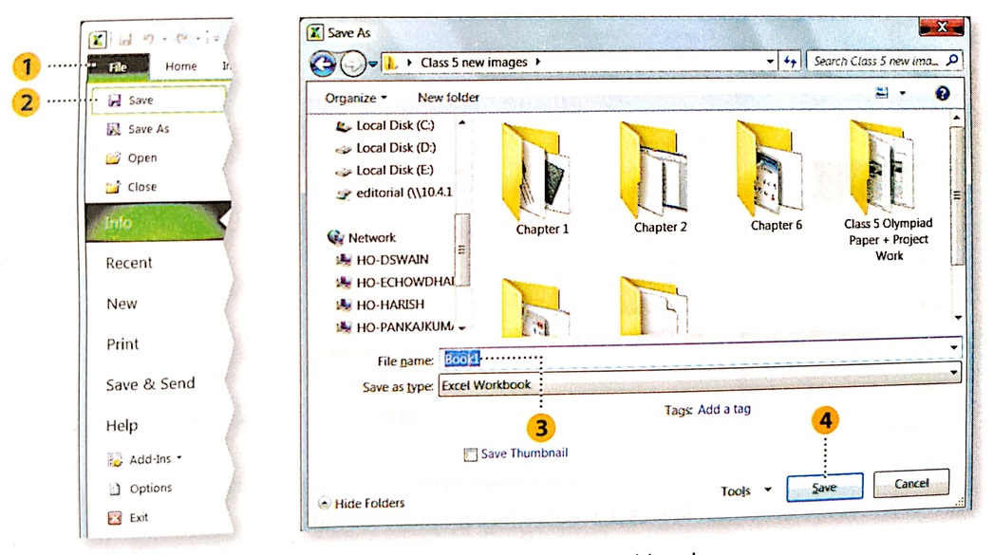
Saving a Workbook
To save your workbook, follow these steps
Click on the File tab.
Under the File tab, click on the Save option. The Save As dialog box opens.
Enter a file name.
Click on the Save button. Your workbook is now saved.
Remember: an Excel workbook is saved with the extension .xlsx

Slide 19
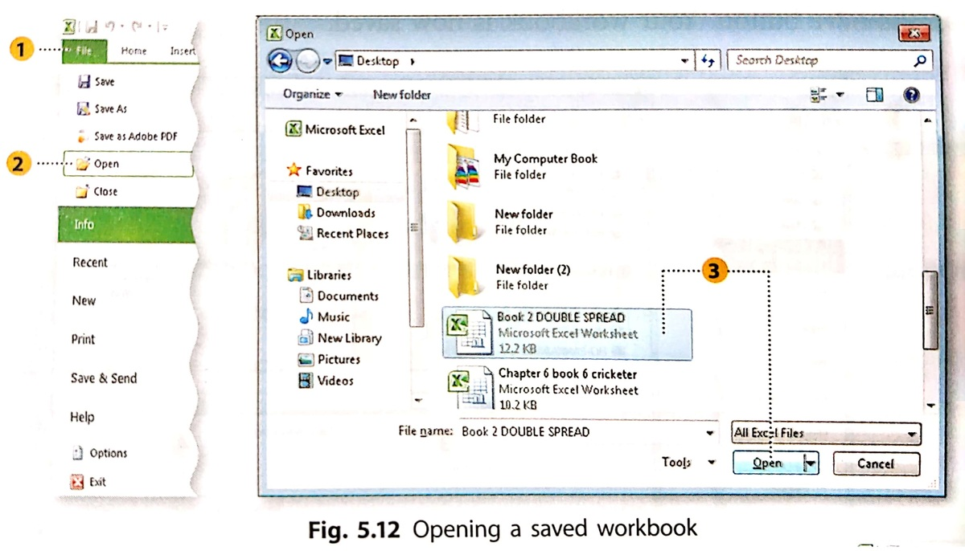
Opening A Saved Workbook
To open a saved workbook, follow these steps:
Click on the File tab.
Under the File tab, click on the Open option. The Open option dialog box appears.
Select the workbook and click on Open.

Slide 20
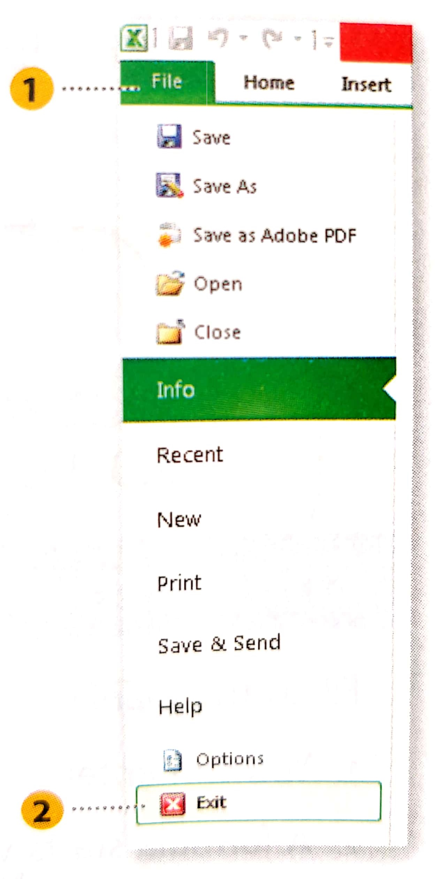
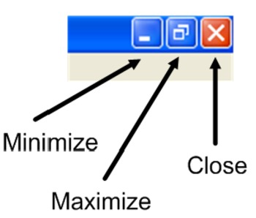
Exiting Excel
To exit from an Excel workbook, follow these steps:
Click on the File tab.
Under the File tab, click on the Exit option.
You can also exit the Excel window by clicking the Close button.

Slide 21
THANK YOU STUDENTS!

