Slide 1
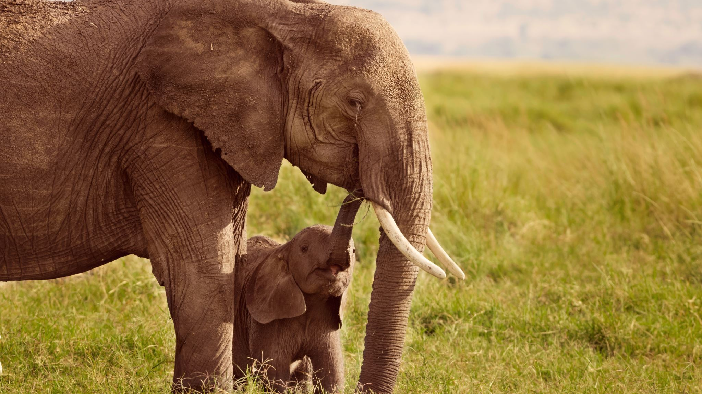
Reproduction
Chapter 1

Slide 2
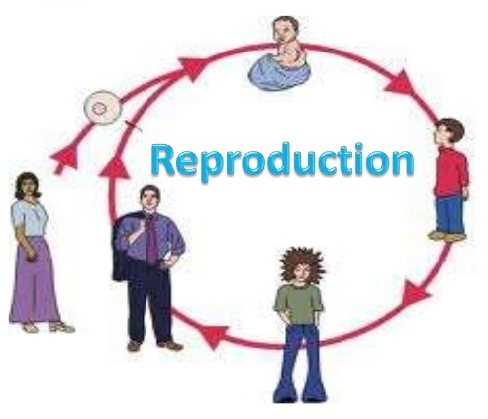
What is reproduction?
Reproduction means to reproduce.
It is a process by which new individual organisms (offspring) are produced from their parents.
Both plants and animals give rise to offspring.

Slide 3
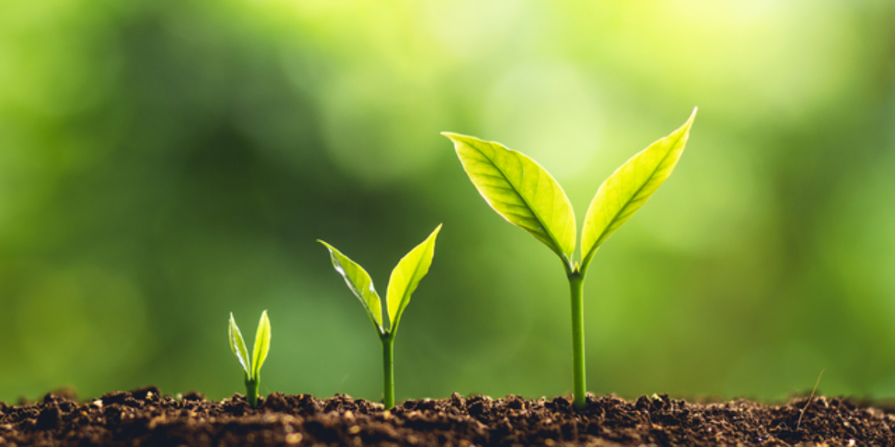
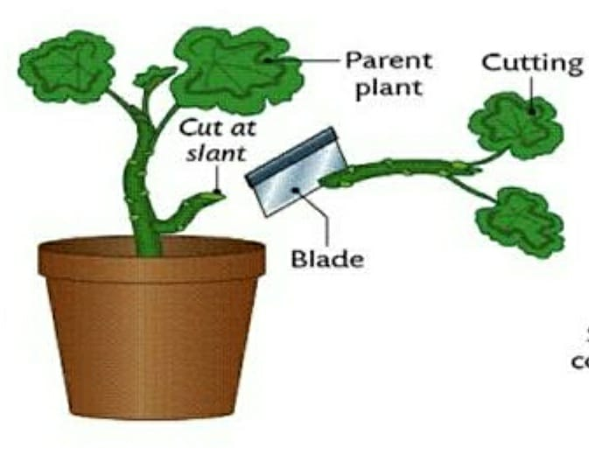
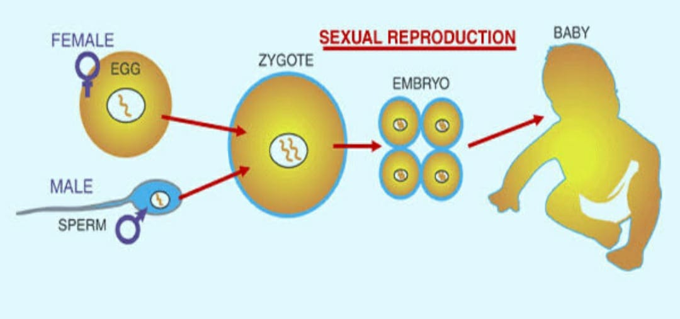
Reproduction in Plants
1. Vegetative reproduction or asexual reproduction
Plants reproduce in two ways:
2. Reproduction from seeds or sexual reproduction.

Slide 4
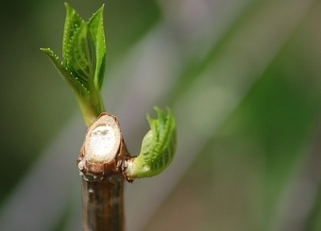
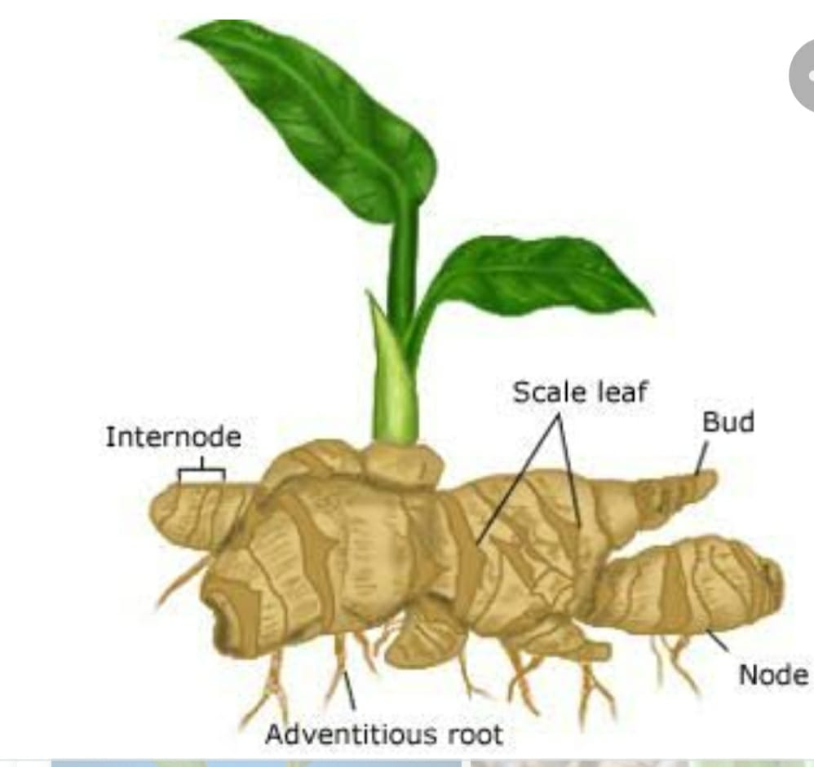
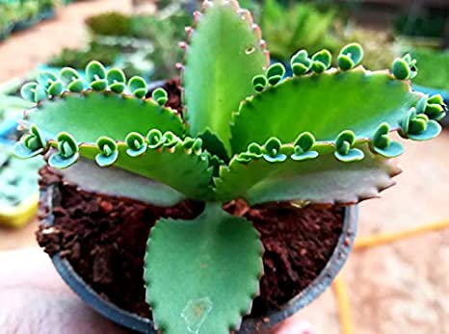
VEGETATIVE REPRODUCTION:
It is a type of reproduction in which new plants similar to the parent plant are reproduced through the stem, root or leaf.
Some plants grow from the pieces of their stems. These pieces are called stem cutting. Examples: Rose, hibiscus, sugarcane etc.
Some plants like potato and ginger grow from their underground stems. These stems bear buds on them. New plants grow from these buds.
Some plants grow from their underground roots. Example : radish, sweet potato.
Some plants grow from the bulbs (underground stem ) of the mother plant. Example Lily and onions.
Some plants like bryophyllum grow from the buds present on their leaves.

Slide 5
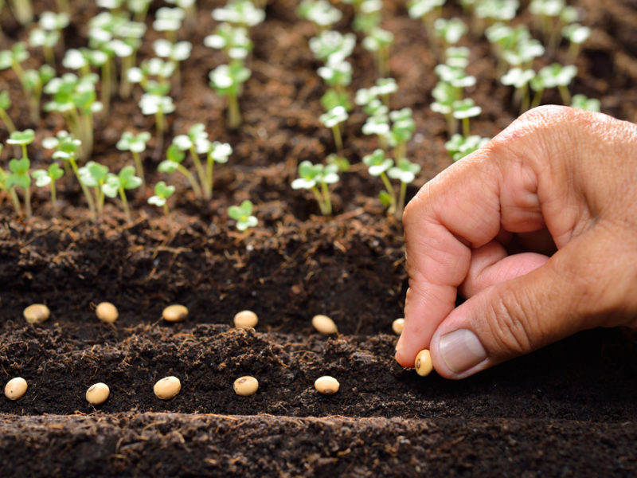
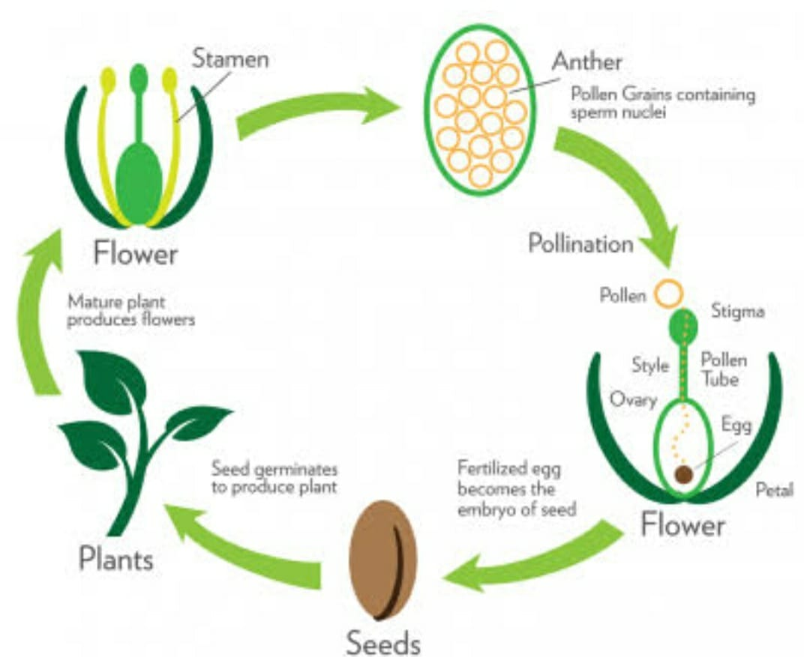
Reproduction through seeds
In flowering plants, after pollination and fertilisation, a special structure called seeds are formed.
Seeds themselves grow into a new plant.
The seeds are dispersed by agents air, water and animals.
All seeds do not grow into plants. Most of them are eaten or crushed.

Slide 6
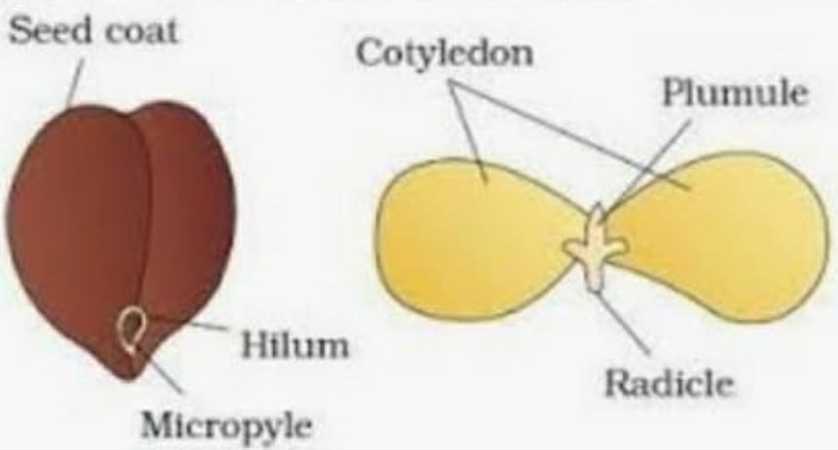
Structure of Seed
Seed coat : Outer protective covering of a seed.
Micropyle : Tiny hole through which water enters.
Cotyledons : They are the first leaves produced by plants and are also called ‘seed leaves’. It stores food for new plants.
Plumule : Tiny shoot that grows upward.
Radicle : Tiny root that grows downward.

Slide 7
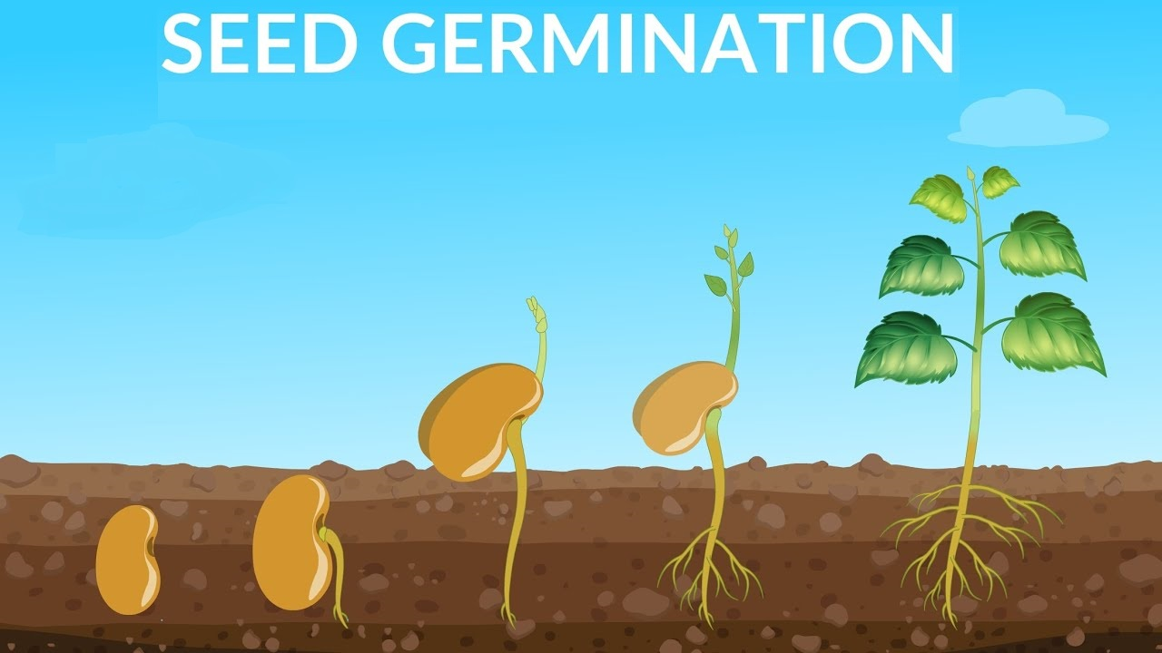
The process of growing of a seedling from a seed is called germination.
Plants produce many seeds but only a few of them are able to grow into new plants.
The seed will germinate only if the conditions are right.

Slide 8
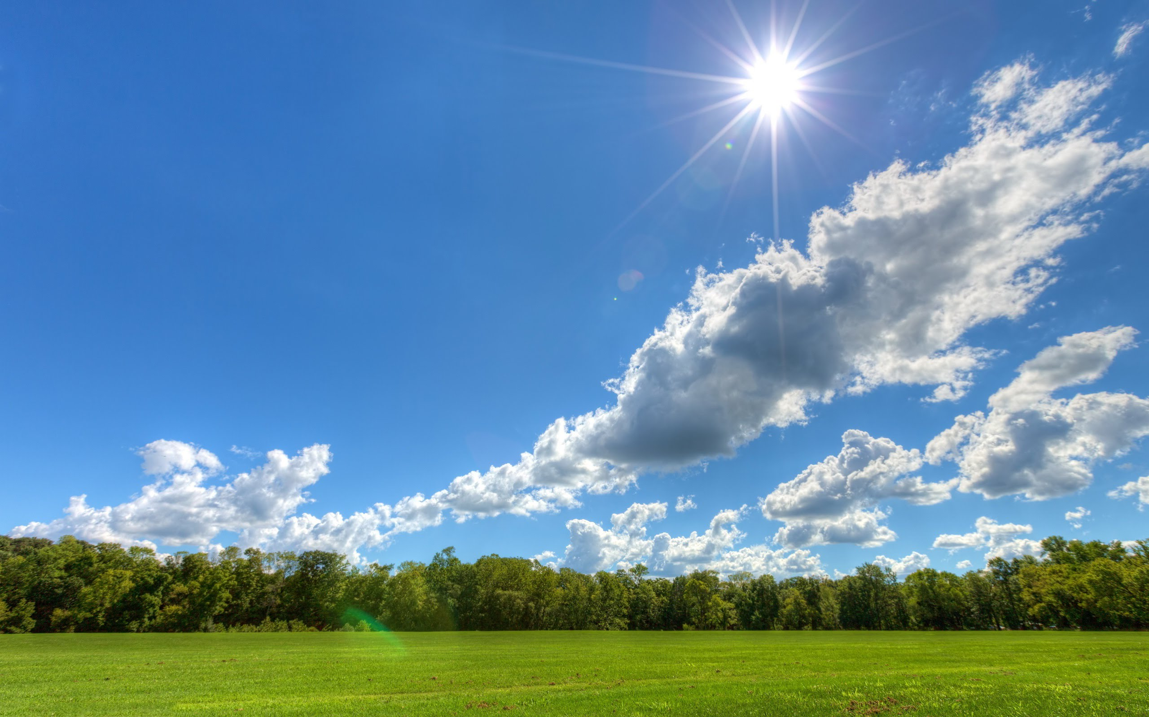
Conditions necessary for germination
CONDITIONS | PROCEDURE | Observation | Result/Conclusion
Water | Take two troughs. Trough 1- Dry seeds Trough 2- Wet seeds | Trough 1- Shows no germination as water is absent. Trough2- Shows germination | Water is essential for germination.
Air | Take soaked seeds in a air tight container. | Seeds show no germination although water was present. | Air is essential for germination.
Sunlight | Take some seeds soaked in water. Keep them in a dark room ( no sunlight). | Seeds show no germination. | Sunlight is necessary for germination.
Temperature | Take some soaked seeds and put it in a refrigerator. Take some more seeds and place it in a high temperature. | Seeds show no germination. Seeds show no germination | Right temperature is necessary for germination.

Slide 9
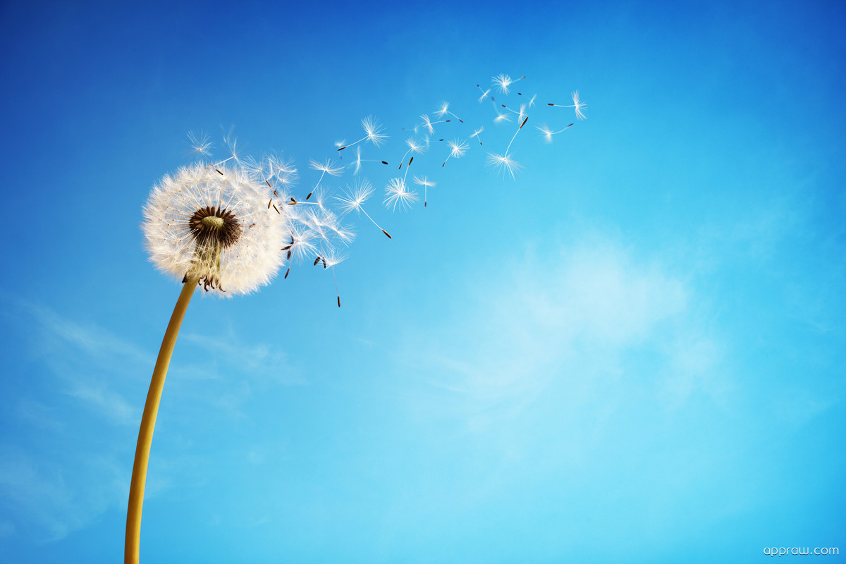
Dispersal of seeds
It is a natural process of movement or transfer of seeds away from the parent plant.
There are many agents to transport seed from one place to another.

Slide 10
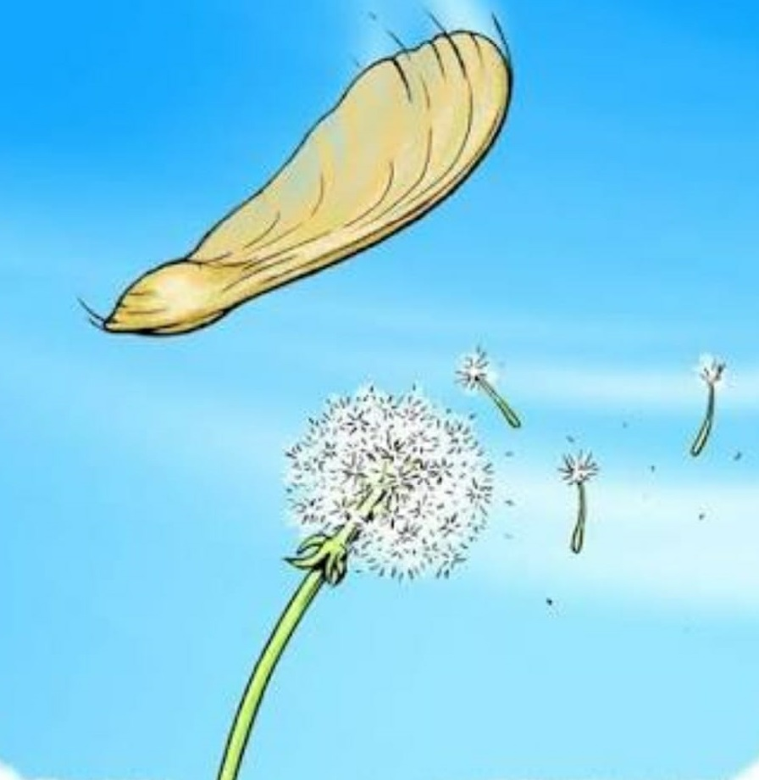
Dispersal by winds:
The wind is the natural means of seed dispersal in the plant. Some seeds (say orchids) are very light weight and are easily blown away by winds. Madar and cotton seeds have wings or hairs on them for easy dispersal.
(b) Dispersal by Running water:
In this method of seed dispersal , seeds float away from parent plant. Example: water lily, coconut, lotus.

Slide 11
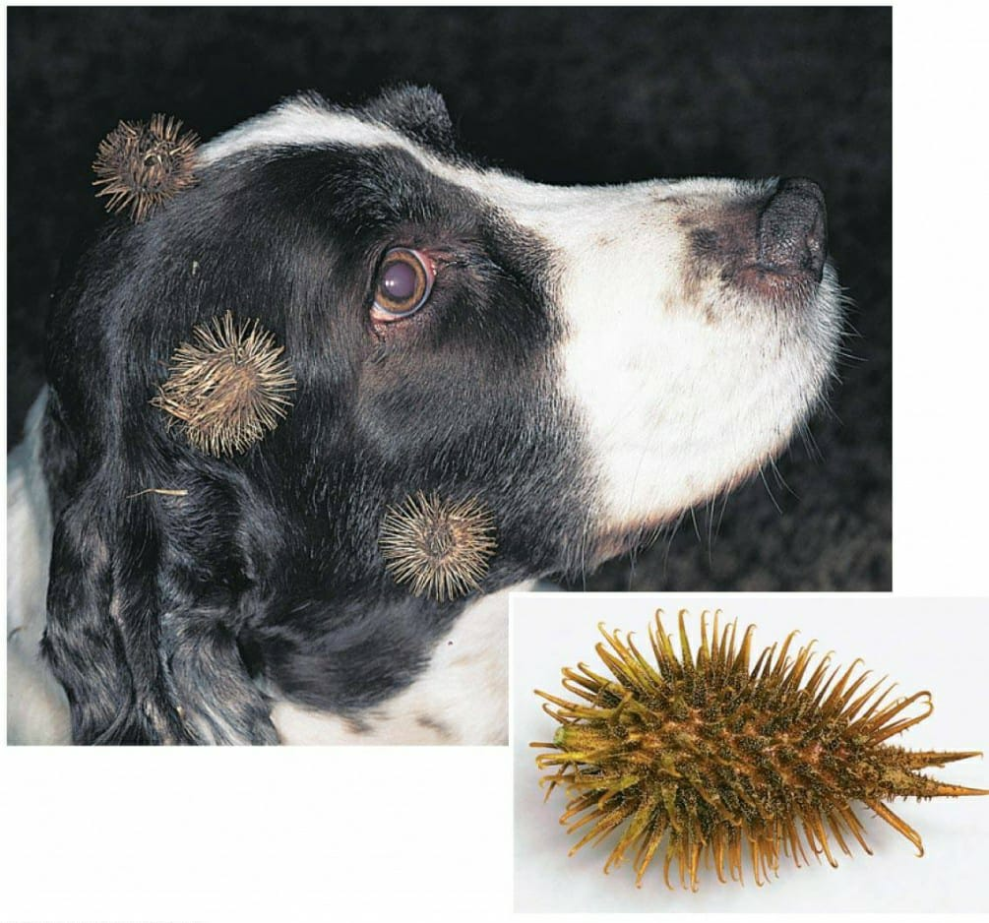
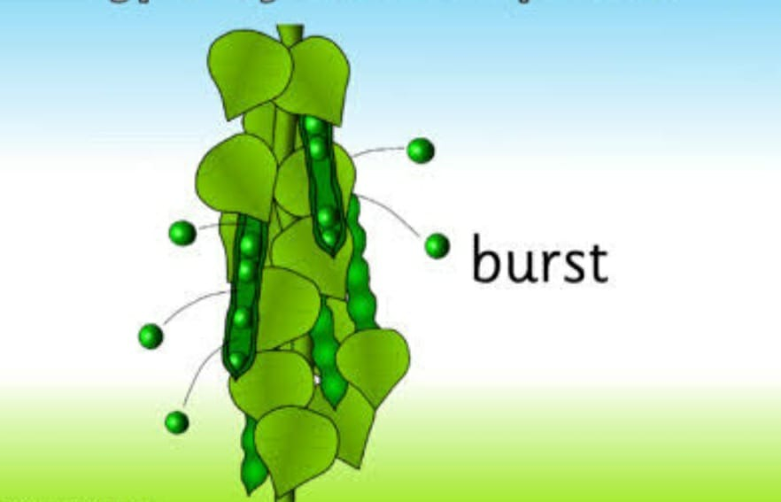
(c) Dispersal by animals and birds:
Some dry fruits have hooks, spines or thorns. These stick on the fur of the passing animals and later fall off.
Strawberries and blackberries have juicy outer coat which are eaten by birds. The birds throw away the seeds at other places. Caltrop, Medicago and Xanthium are eaten away by animals and come out as unharmed along with other undigested part.
(d) Dispersal by explosion:
The seed pods of pea plant when ripens , a tension is set-up in the cells. Finally it bursts with some force and the seeds are dispersed

Slide 12
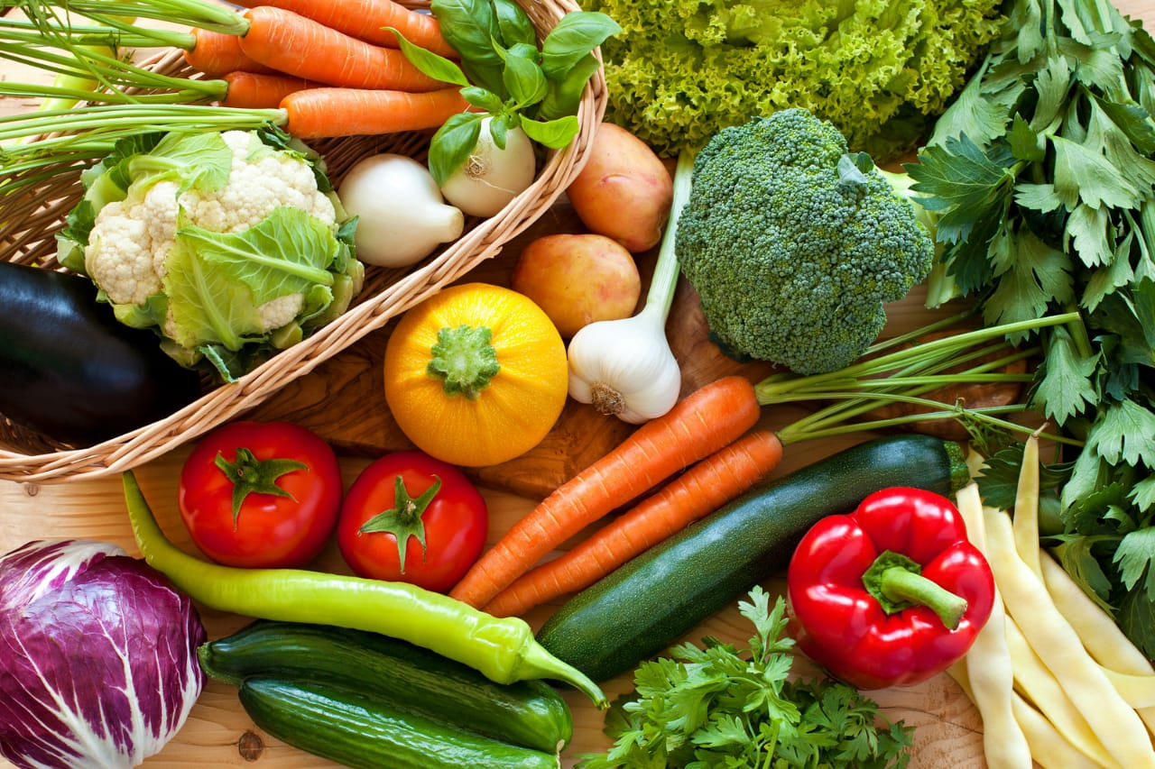
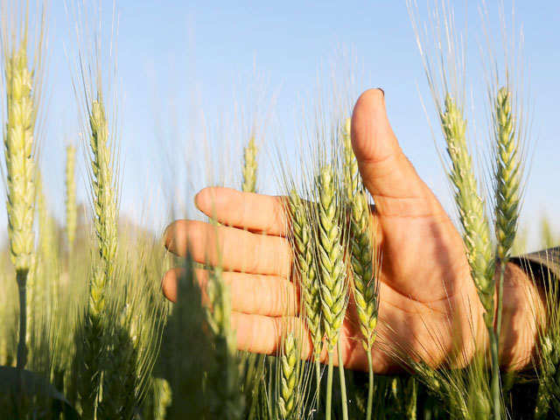
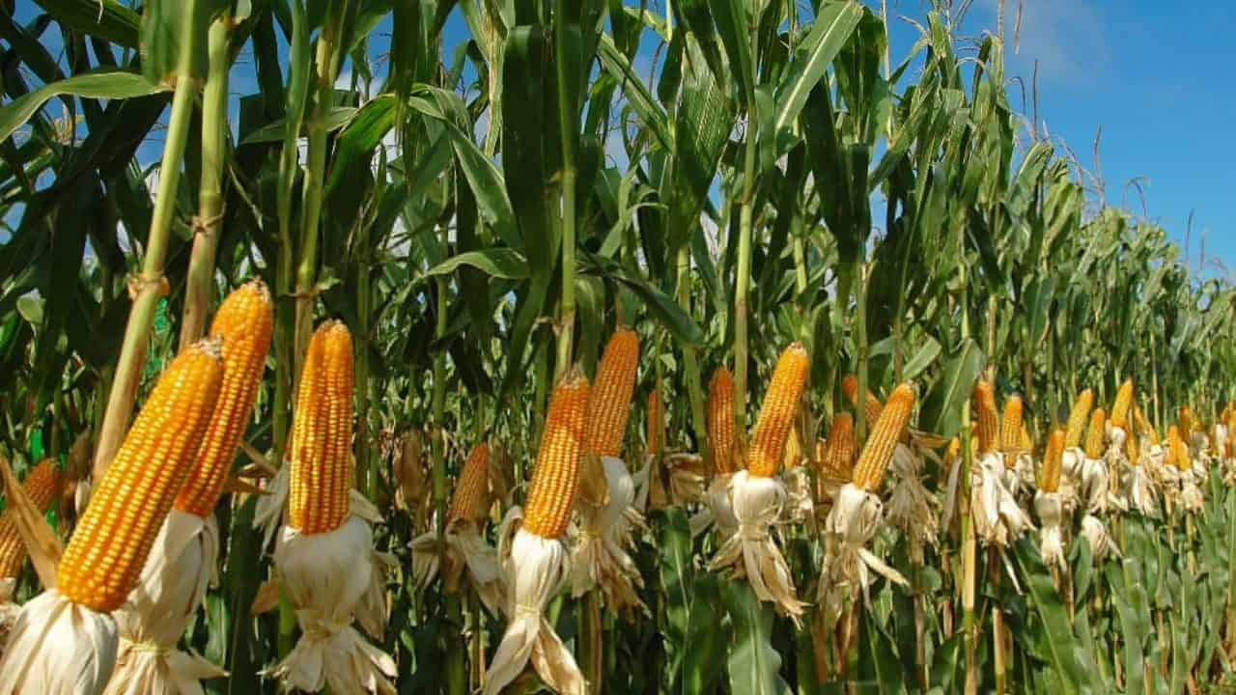
CROPS AND VEGETABLES
Different crops grow in different seasons. They also require different kinds of soil to grow.
Rabi crops: Crops grown in winter season are called rabi crops. Example: wheat and gram
Kharif crops: Crops grown in summer season are called kharif crops. Example: rice, maize, bajra , jowar.
Plantations: An estate or place on which plants such as coffee, tea , rubber are grown. Tea plants are grown mostly in Assam, Nilgiris and Darjeeling.
Vegetables: Vegetables are grown all over the country. Pumpkins and brinjals grow well in summers. Cauliflower, peas and beans grow well in winter.

Slide 13
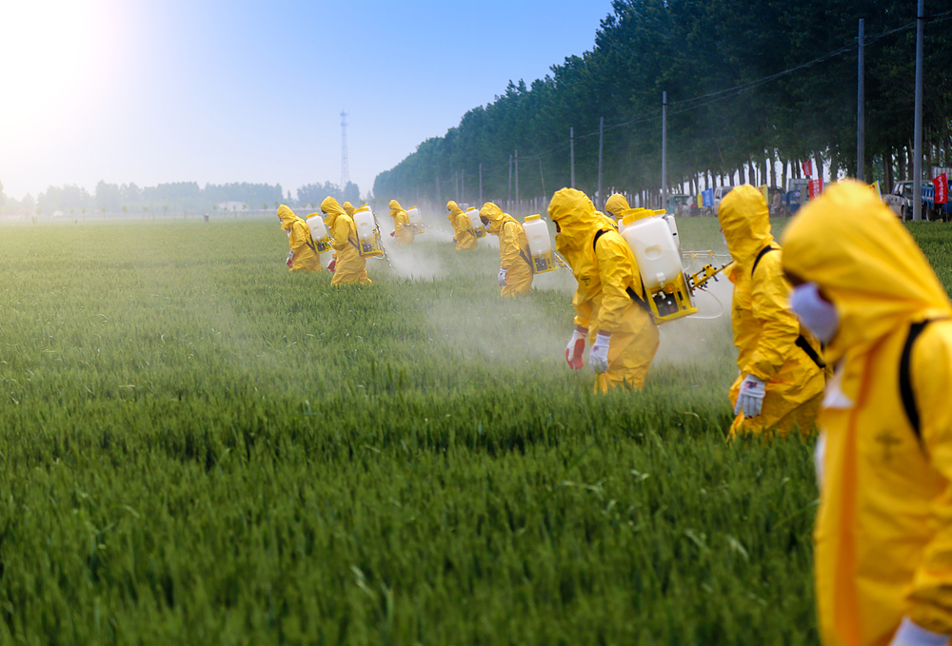
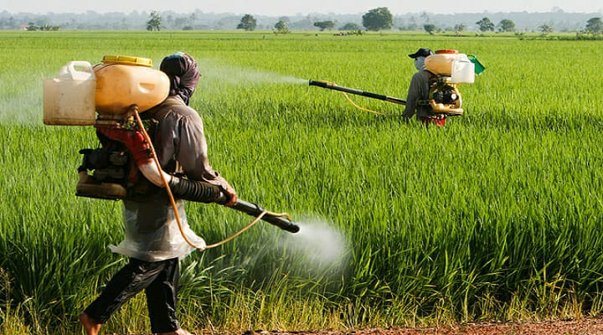
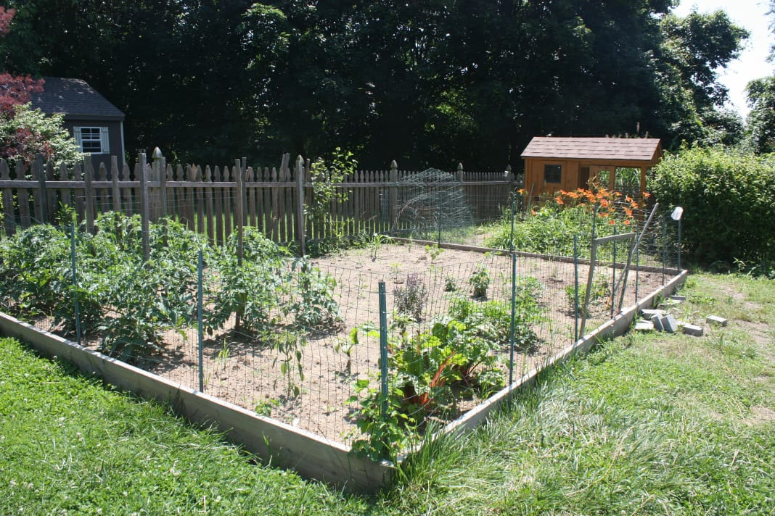
Protection of crops
(1) Crops must be protected from diseases and harmful insects.
Insecticides and pesticides (gammaxene) have to be sprayed to protect the crops.
Chemicals should be used in correct amount.
(2) Crops can be protected from animals like cows, buffaloes by building fences around the fields.
(3) Crop rotation helps to prevent diseases and even makes the soil fertile.

Slide 14
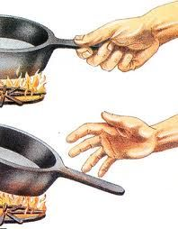
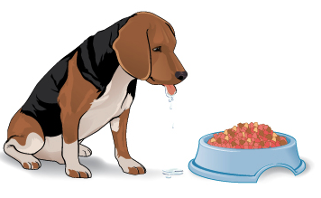
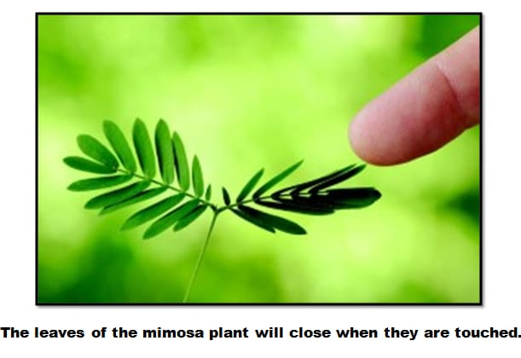
Response to stimuli in Living Things
Stimulus: It is something which causes a living thing to react or to respond. For example if by mistake we touch a hot pot, we withdraw or pull our hand back immediately. Plant automatically grow towards sunlight.
Response: Any reaction of a living thing to a stimulus is called a response. Pulling our hand away when we touch a hot pot is an example of response.
Most of the animals respond to stimulus by either moving towards or away from it.
Plants also respond to external stimuli:
A potted plant kept near the window grows towards the light.
The leaves of Touch-me-not plant (mimosa) fold with the slightest touch.
Night jasmine and magnolia bloom only at night.

Slide 15
Thank you students!

