Slide 1
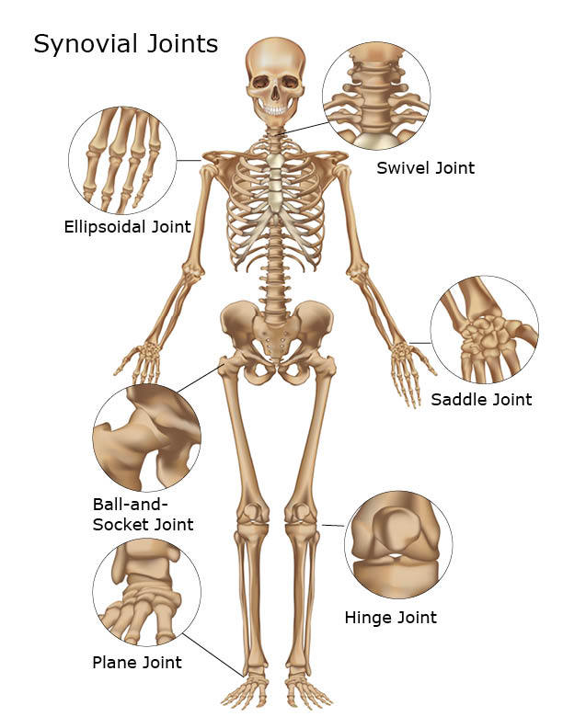
JOINTS
A point where two bones meet is called a joint.
Ligaments are strong tissues which connect bone to bone and give support to the joints.
Tendons are fibrous tissues which connect muscles to bones.

Slide 2
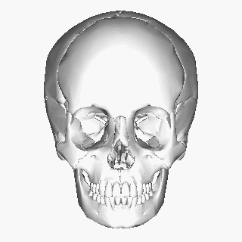
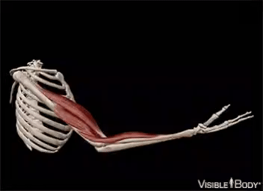
TYPES OF JOINTS
Movable joints
Immovable Joints
Movable joints are joints which helps the bones at the joints to move freely with the help of a fluid called synovial fluid, which acts as a lubricant.
Immovable joints are joints that connect the end of the bones by a tough fibrous tissue. Example: sutures found between the bones of the skull.

Slide 3
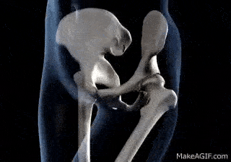
Types of Movable Joints
Hinge joint: Bones connected in this way can move only in one direction like the hinges in a door. It allows only up and down movement. E.g. elbow, knee, toe and finger.
Ball and Socket Joint: In these joints, one bone has a hollow socket into which another bone fits. It allows 360⁰ movement (in all directions). E.g. Hip and shoulder bone.

Slide 4
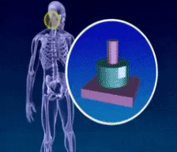
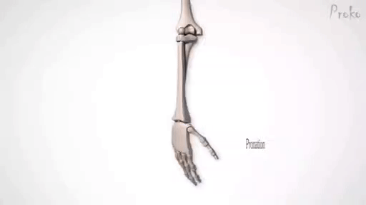
Pivot Joint: This joint allows the skull to move side to side and up and down. It is found between the skull and the first two vertebrae of the spine. Atlas is the uppermost vertebrae in the neck.
Gliding joints: One end of the bone glides across the other bone. It allows the movement between the connecting bones. E.g. wrist, ankle and between the two vertebrae.

Slide 5
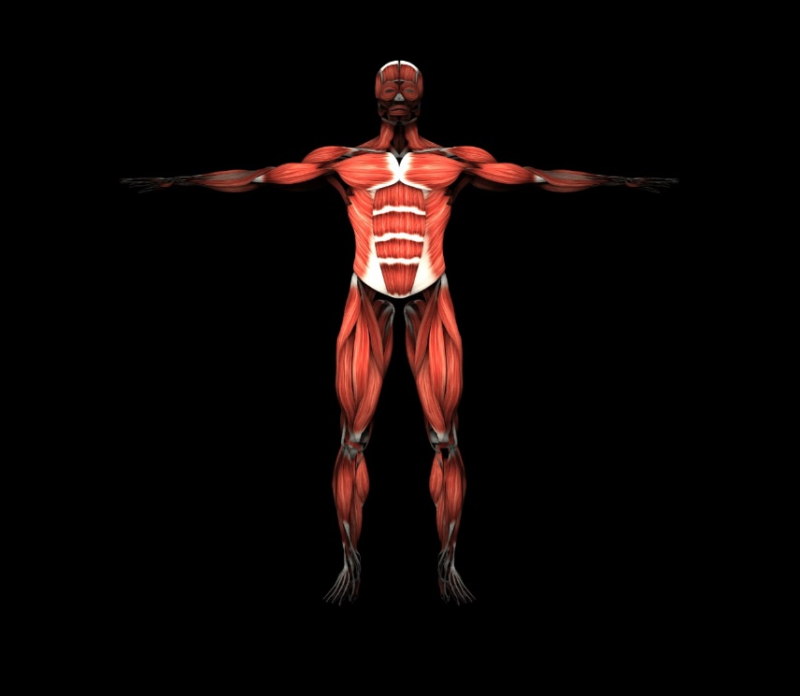
MUSCLES
Muscles in our body shorten and lengthen to allow movement of the bones. There are about 650 muscles in our body. We use 14 muscles just to smile. Muscles work in pairs. They contract and relax. When you flex a muscle, it contracts and when a muscle is relaxed it goes back to its original shape.

Slide 6
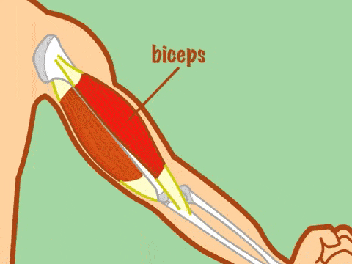
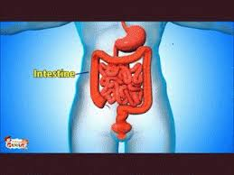
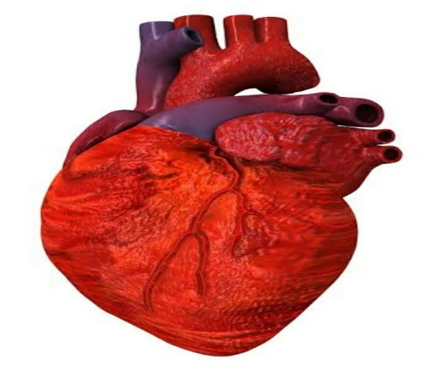
TYPES OF MUSCLES
Voluntary or Striped Muscles: These muscles are under the control of our will. It brings about the movement of the skeleton. E.g. muscles of Biceps, Triceps, Hamstring, etc.
Involuntary or Smooth Muscles: These muscles work on their own. E.g. Lining of the internal organs like stomach, intestine esophagus, etc.
Cardiac Muscles: These are involuntary muscles that work day and night tirelessly. It is found only in the heart and is responsible for keeping the heart pumping and relaxing normally.

Slide 7
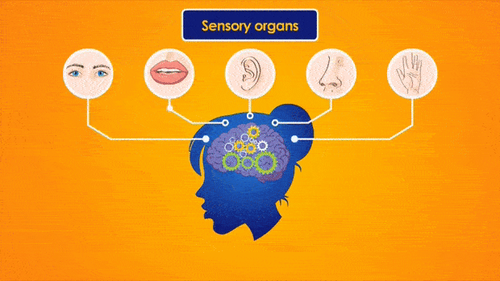
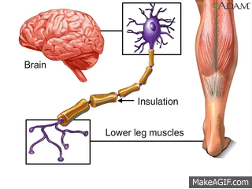
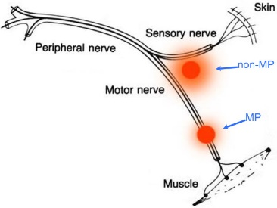
NERVOUS SYSTEM
The Brain, the Spinal Cord and the Nerves together form the Nervous System. It controls the other systems of our body. The nerve cells or neurons are the structural and functional unit of nervous system.
NERVES: Nerves are like telephone wires that connect every part of the body to the central nervous system (CNS). There are three kinds of nerves:
Sensory nerves: They carry messages from the sense organs to the brain or the spinal cord.
Motor nerves: They carry messages from the brain or the spinal cord to the muscles or glands.
Mixed nerves: They carry messages to the brain as well as bring orders from the brain.

Slide 8
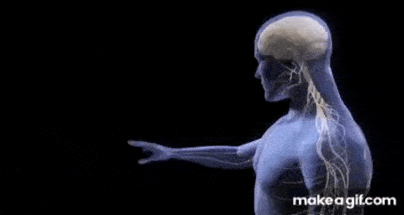
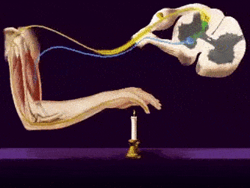
Reflex Action: Sometimes accidentally when you step on a thorn, your foot automatically pulls away. Such actions where you do not stop to think, are known as ‘reflex actions’. These are controlled by the spinal cord.

Slide 9
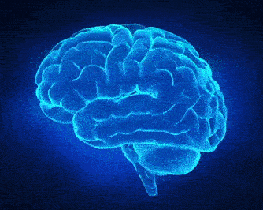
THE BRAIN
The brain is like a super computer. It weighs about 1.4kg and contains millions of tiny cells. It is protected by a hard, bony skull called cranium. It is the control centre of the human body.
Function: It receives information from all parts of the body through the different nerves.

Slide 10
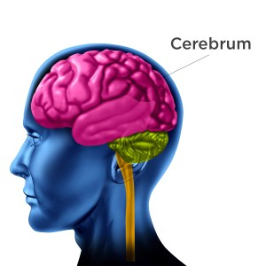
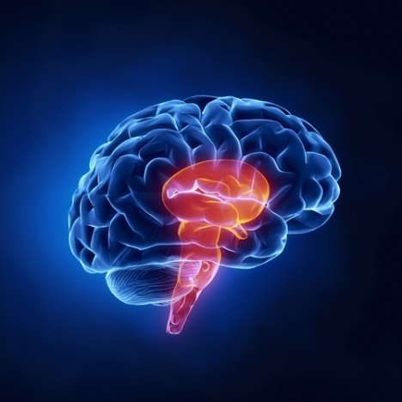
PARTS OF A BRAIN
Cerebrum: It is the largest part of the brain and has deep folds.
Function: It is the centre of our intelligence. It controls our memory, thinking and reasoning.
2. Cerebellum: It is located under the cerebrum.
Function: It maintains posture, balance and coordinates muscle movement.
3. Medulla Oblongata: It is a long stem like structure which makes up part of the brainstem. It remains active when we are asleep.
Function: It controls the involuntary actions like the movement of the lungs, heart etc. Injury to medulla oblongata can even cause death.

Slide 11
THANK YOU STUDENTS!

