Slide 1
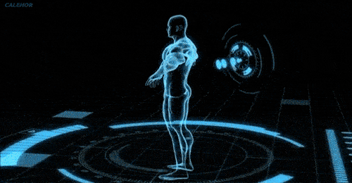
Chapter 3
THE HUMAN BODY A WONDERFUL MACHINE

Slide 2
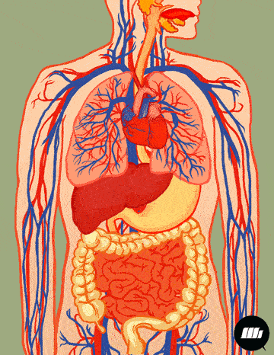
THE HUMAN BODY
All living beings, including human beings, have definite organs and systems to carry out various functions.
The human body is the structure of a human being. It is composed of many different types of cells that together create tissues. The lungs, heart, brain, kidney are all made up of tissues and are subsequently called organs. The organs work in a coordinated manner and make the organ system (digestive system, nervous system etc.). These organ systems work together to make an organism.

Slide 3
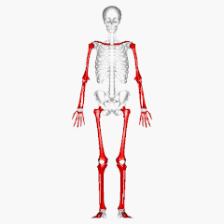
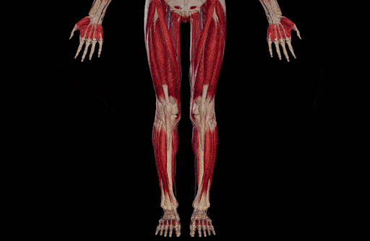
There are many systems in our body. All the systems work together to make our body an efficient machine.
The two systems which work closely together are the:
Skeletal System
Muscular System

Slide 4
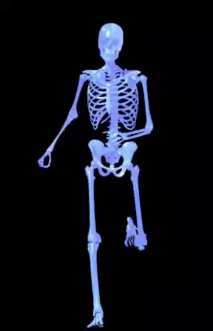
THE SKELETAL SYSTEM
The human skeleton is the internal framework of the human body. It is composed of 270 bones at birth but by adulthood it is around 206 as some bones get fused together.
Function: The skeletal system supports the body, protects the internal organs and gives the body shape and size.

Slide 5
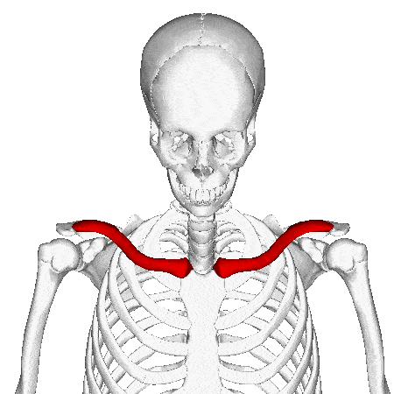
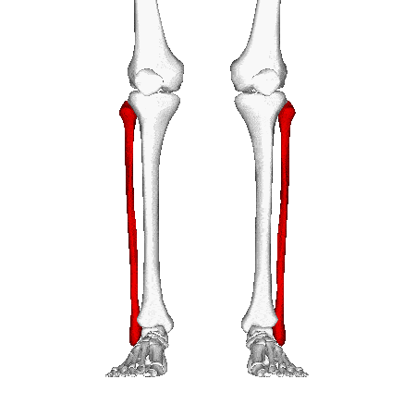
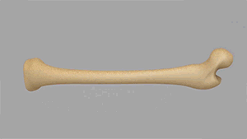
BONES
Bones are hard, porous (tiny holes) tissues.
It has a good supply of nerves and blood vessels.
Nerves and blood vessels enter the bone through these pores.
Bones are made up of living cells.
The cavity of the bones are filled with bone marrow.
All the blood cells - Red blood cells, White blood cells and Platelets are produced here.
Function:
Red blood cells(RBC) carry oxygen to different parts of the body.
White blood cells(WBC) protects us against germs and infection.

Slide 6
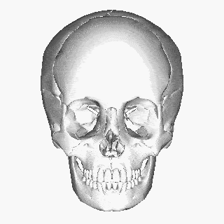
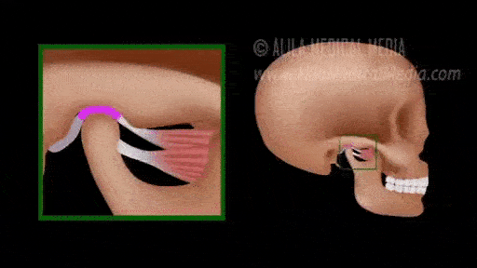
PARTS OF THE SKELETON
1. The Skull: The skull is made up of eight flat bones that are interlocked together. There are 14 facial bones that protect the major sense organs.
Function: The skull encloses the delicate brain inside and protects it from outer physical injury or shocks.
2. The Jaws: There are two jaws, upper jaw is a part of the skull and only the lower jaw is movable.
Function: It enables all the animals to chew food and the humans to talk and chew food.

Slide 7
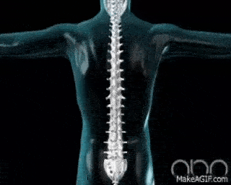
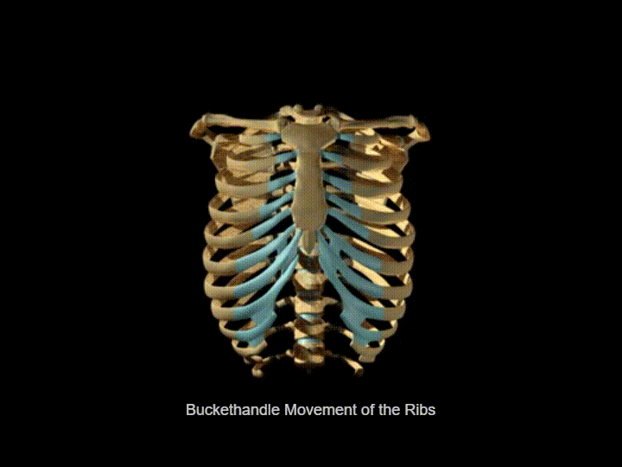
3. The Backbone and Spine: The backbone forms the main axis of the skeleton on which the skull rests. It is made up of 33 bones called vertebrae.
Function: It protects the delicate spinal cord.
4. The Ribs: 12 pairs of long curved bones called ribs form the ribcage. All 12 pairs of ribs are joined with the backbone. Out of 12 pairs, only 10 pairs are joined in the front with the breastbone and the last 2 pairs are free at the front end and called Floating ribs. Delicate organs like heart, lungs are inside this cage.
Functions: The ribs protect the heart and lungs from injury.

Slide 8
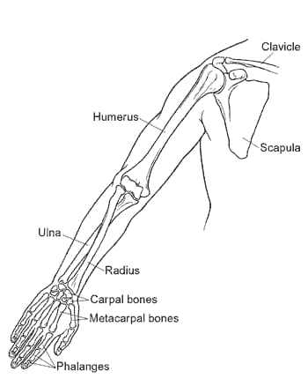
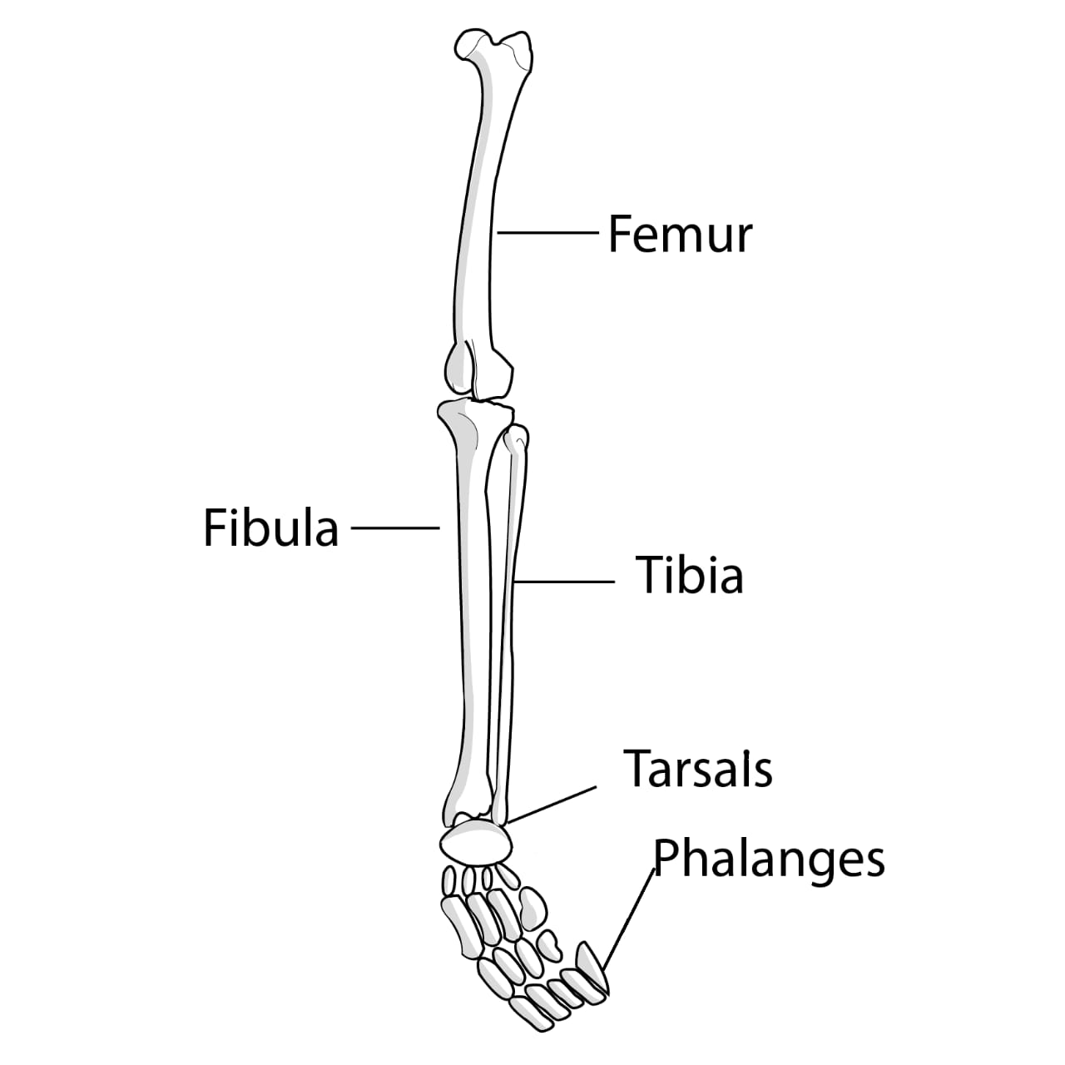
5. The Limbs: Our body has a pair of forelimbs or arms and a pair of hind-limbs or legs. The shoulder girdle and the pectoral girdle join the bones of the arms with the spine. Femur or thigh bone is the longest bone in the human body which fits into the hip girdle.

