Slide 1
Good Morning Students!
Our lesson today is on FRACTION

Slide 2
FRACTION
Fraction is something that shows parts of a whole or equal parts of a whole.
In a fraction, the numerator shows how many parts we are talking about and the denominator number shows the total number of parts.
Whole: A complete or a full object is called as a Whole.
1 Numerator
3 Denominator
5 Numerator
7 Denominator

Slide 3
FRACTIONS OF A COLLECTION
To find One – Half of a collection, we must divide by 2.
Let’s say, Tina has 8 oranges. She wants to give half of them to Suraj. How many oranges should she give to him?
Firstly she divides the 8 oranges into two equal groups.
Then she gives Suraj one half of 8 oranges
i.e. 1 of 8 = 8 ÷ 2 = 4
2
So Tina should give Suraj 4 oranges

Slide 4
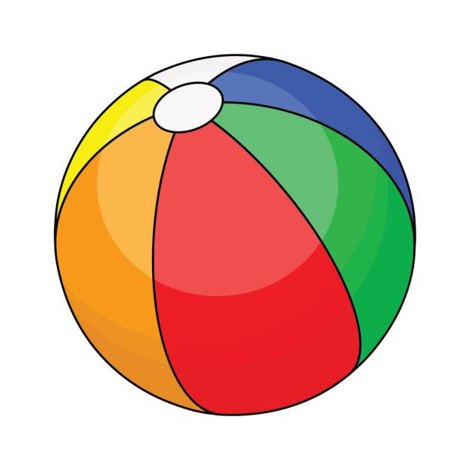
FRACTIONS OF A COLLECTION
To find One – Third of a collection, we must divide by 3.
Let’s say, Suraj has 12 balls. He wants to give one - third of them to Karan. How many balls should he give to him?
Firstly he divides the 12 balls into three equal groups.
Then he gives Karan one - third of 12 balls
i.e. 1 of 12 = 12 ÷ 3 = 4
3
So Suraj should give Karan 4 balls.

Slide 5
FRACTIONS OF A COLLECTION
To find One – fourth of a collection, we must divide by 4.
Let’s say, Suraj has 12 beyblades. He wants to give one - fourth of them to Karan. How many beyblades should he give to him?
Firstly he divides the 12 beyblades into four equal groups.
Then he gives Karan one - fourth of 12 beyblades.
i.e. 1 of 12 = 12 ÷ 4 = 3
4
So Suraj should give Karan 3 beyblades.

Slide 6
FRACTION WORD PROBLEMS
Avinash had 20 stickers. He gave 4 stickers to his sister. What fraction of stickers did Avinash give to his sister?
Total stickers = 20
Number of stickers given to his sister = 4
Fraction of stickers Avinash gave to his sister =
Ans. Avinash gave his sister stickers .
4 = 1 20 5
1
5

Slide 7
Thank you students!

